Slide 1
Thrive in Place Campus Plan (2025-2035) Z.C. Case No. 23-08(1) CLC – February 20, 2025 www.wesleyseminary.edu/wesley-masterplan-updates

Slide 2
introduction
Rev. Dr. David McAllister-Wilson
President, Wesley Theological Seminary
John Patrick Brown, Jr., Esquire
Greenstein DeLorme & Luchs, P.C.
Stephen C. Karcha, CM, LEED AP, GRP
Advanced Project Management, Inc.
Eric Leath
Tucker Snipes
Landmark Properties
Cynthia A. Giordano, Esquire
Saul Ewing, LLP
William Zeid, P.E.
Gorove Slade

Slide 3
WELCOME Rev. McAllister-Wilson
Update on Wesley 2025
Why Thrive in Place
Wesley is Not Wealthy
Limited Endowment
Subsidize Wesley Tuition/Housing Costs
Minimize Student Loan Debt
Need Modern Student and Family Housing
Attract and Retain Best Faculty and Students

Slide 4
PROCEDURAL UPDATE Patrick Brown
ZC 24-09: ZC Final Action on February 27 at 4:00pm
ZC 23-08(1): Updated Campus Plan Submission and Request to Resume Public Hearing
ZC 23-08: PUD Withdrawn
ANC 3D: March 5, April 2 at 7:00pm
ANC 3E: March 13, April 10 at 7:30pm
Next CLC: To Be Determined
Further Processing – Upon Approval of Campus Plan

Slide 5
CAMPUS PLAN UPDATE Patrick Brown
Eliminated Top/Penthouse Level of New Dorm
Eliminated Administration/Maintenance Building
Reduced Total Campus Development to 1.014 FAR
300,740 sf Unused Campus GFA
Reduced Underground Parking
Increased Green Open Space
Enhanced Landscaping
Proposed Ward 3 Inclusionary Zoning Revolving Fund

Slide 6
REVISED NEW DORM PLANS Eric Leath
Eliminated Top/Penthouse Level
GFA Reduced by 17,183 sf
Not More than 659 Beds
Occupied by Wesley and AU Students, Faculty and Staff
Eliminate 99 Underground Parking Spaces
LEED Gold Building Design
Green Roof and Rooftop Solar Panels
Review of Revised Plans/Elevations

Slide 7
REVISED NEW DORM PLANS Eric Leath

Slide 8
View from Massachusetts Ave NW
Summer
The Wesley Campus Plan: The Standard at Wesley I 02.11.2025
8

Slide 9
View from University Ave NW Summer
The Wesley Campus Plan: The Standard at Wesley I 02.11.2025
9

Slide 10
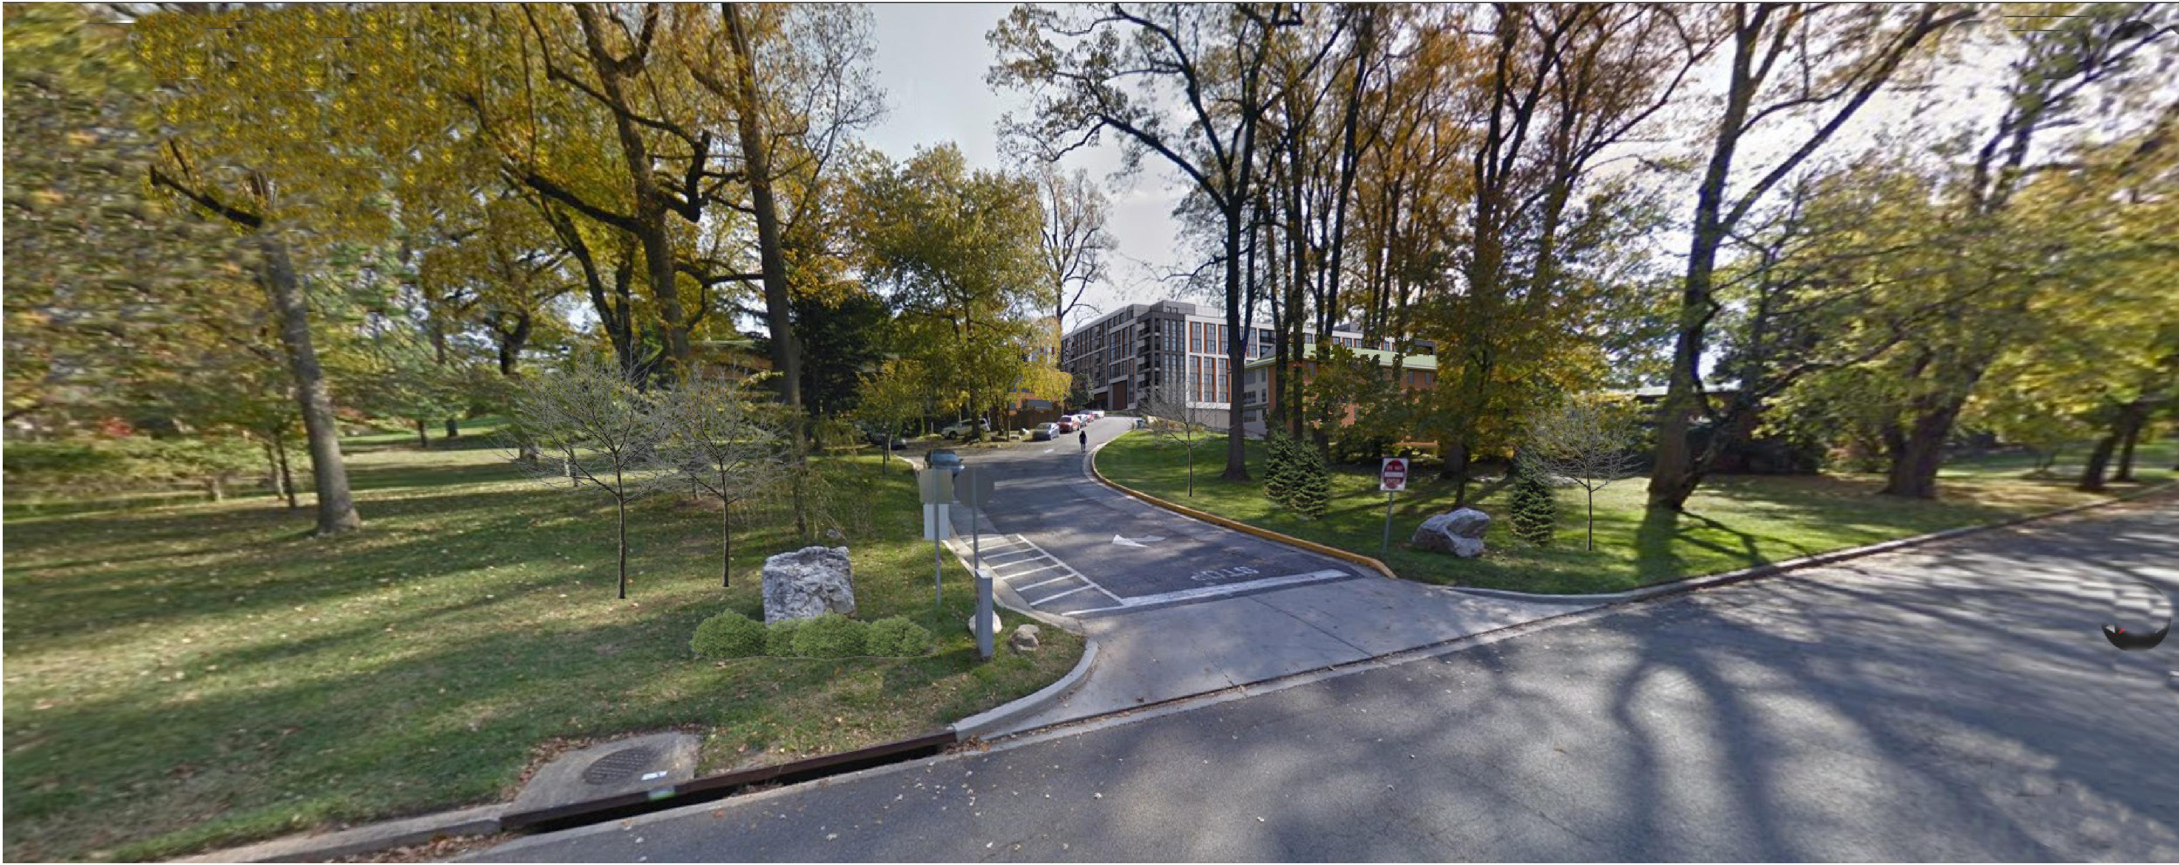
View from University Ave NW Winter
The Wesley Campus Plan: The Standard at Wesley I 02.11.2025
10

Slide 11
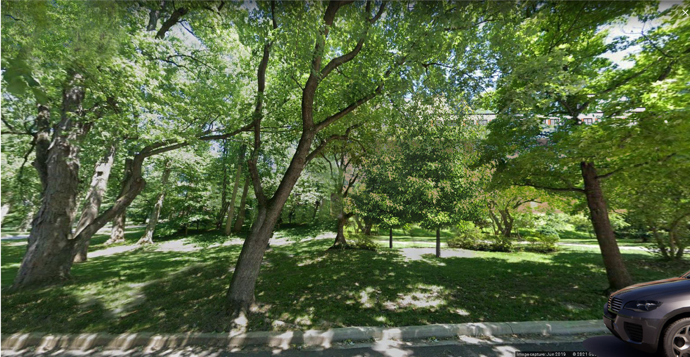
View from University Ave NW
Summer
The Wesley Campus Plan: The Standard at Wesley I 02.11.2025
11

Slide 12
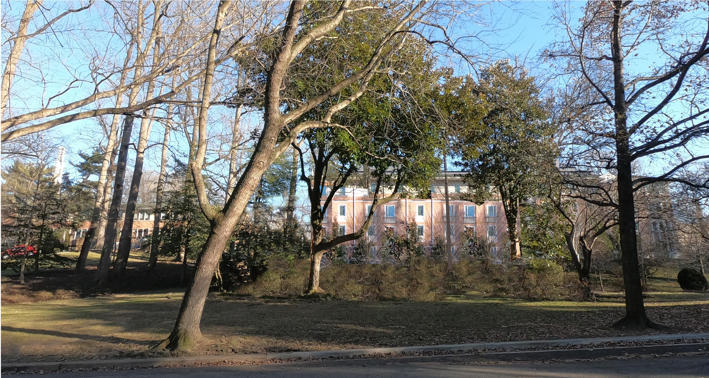
View from University Ave NW
Winter
The Wesley Campus Plan: The Standard at Wesley I 02.11.2025
12

Slide 13
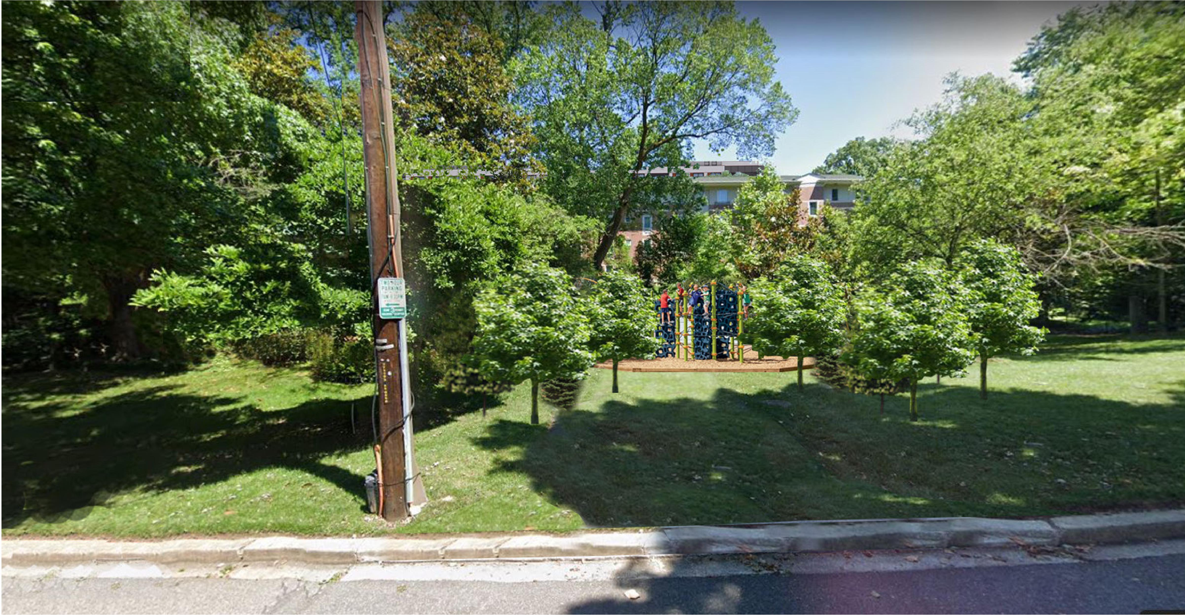
View from University Ave NW Summer
The Wesley Campus Plan: The Standard at Wesley I 02.11.2025
13

Slide 14
View from University Ave NW Winter
The Wesley Campus Plan: The Standard at Wesley I 02.11.2025
14

Slide 15
View from University Ave NW Winter
The Wesley Campus Plan: The Standard at Wesley I 02.11.2025
15

Slide 16
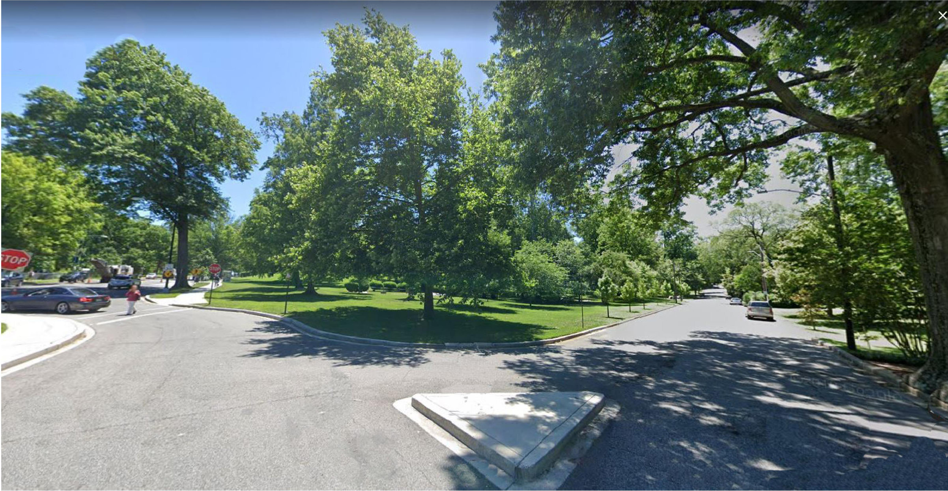
View from Wesley Circle NW Summer
The Wesley Campus Plan: The Standard at Wesley I 02.11.2025
16

Slide 17
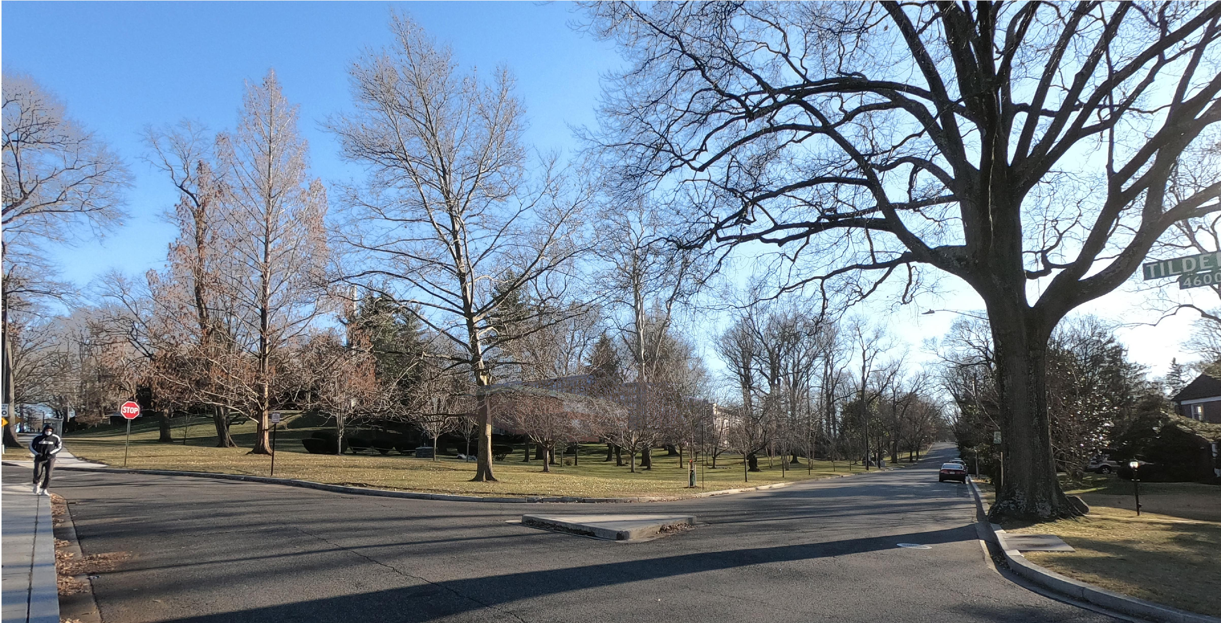
View from Wesley Circle NW Winter
The Wesley Campus Plan: The Standard at Wesley I 02.11.2025
17

Slide 18
BUILDING ELEVATIONS
The Wesley Campus Plan: The Standard at Wesley I 02.11.2025
18

Slide 19
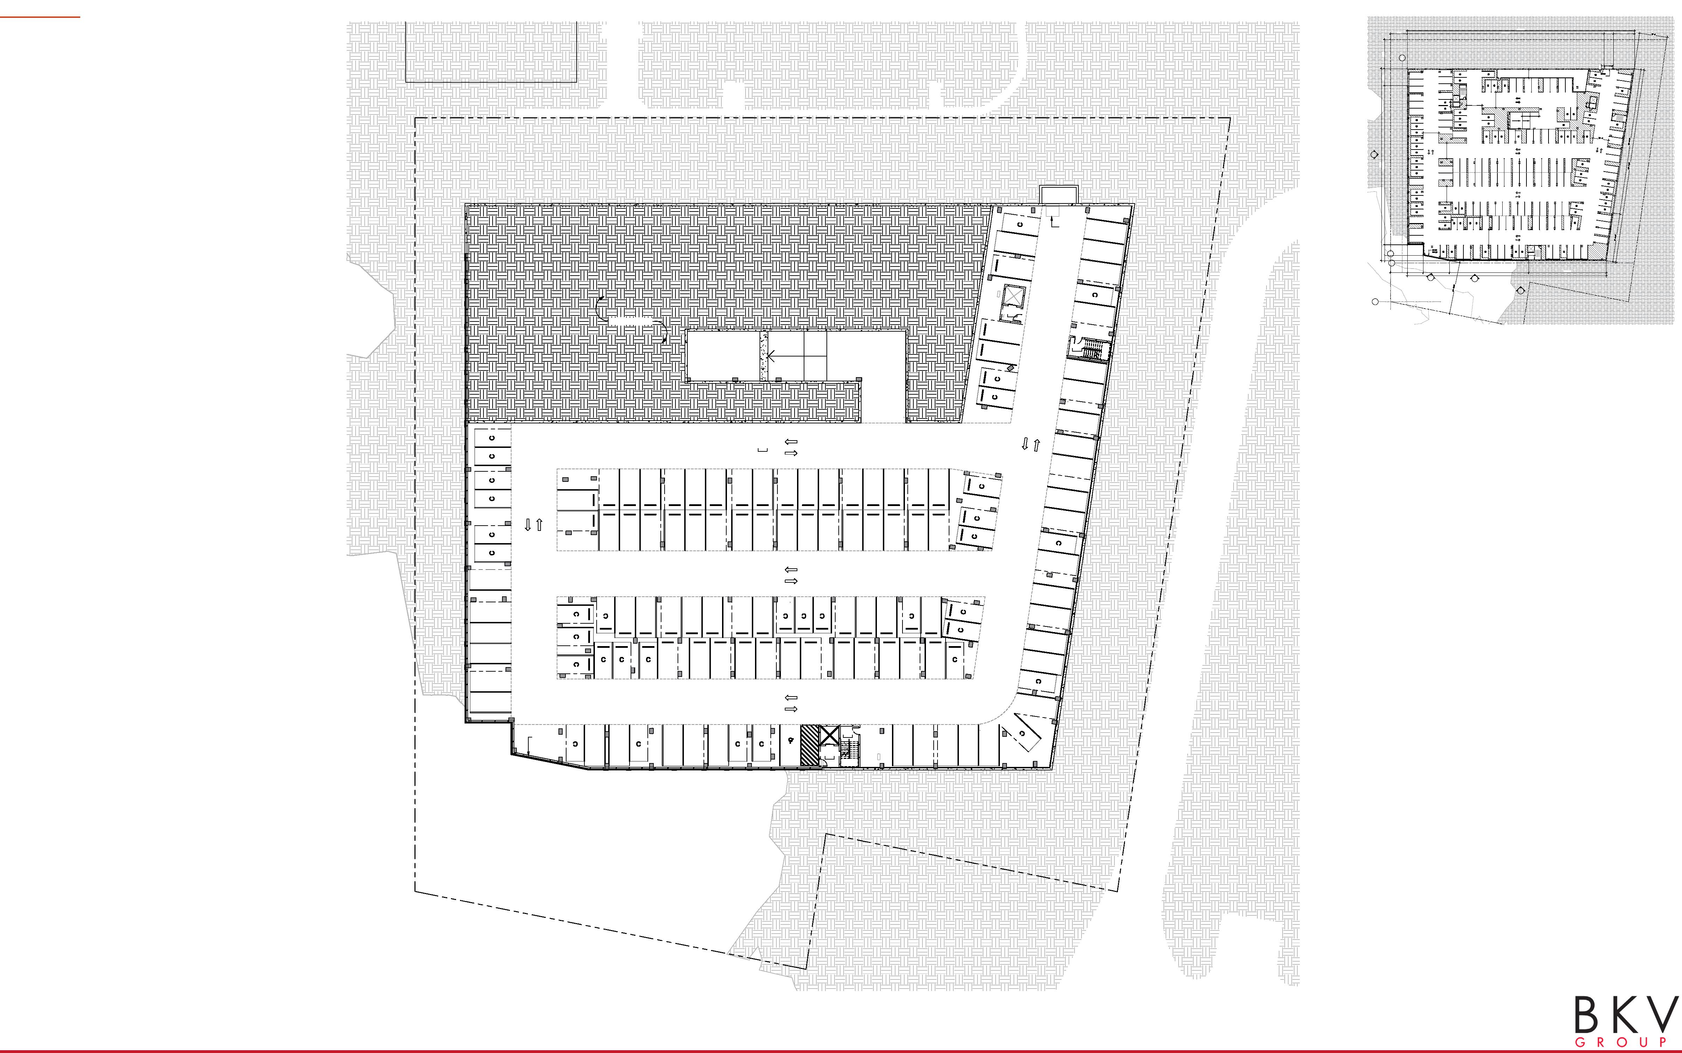
LEVEL P2 TURAL KEYNOTES
PREVIOUS PLAN
293' - 1 5/8"
248' - 0"
6' - 9 ¹/₄" 13' - 9 3/8"205' - 6 3/8"21' - 11"37' - 6"
21' - 9" 253' - 11 3/4" 12' - 0" 27' - 1 ⁷/₈"
1
10' - 7 5/8"
STORAGE
4' - 0"
INTAKE
5' - 8"
ELEV. LOBBY A
20' - 0"
20' - 0"
10' - 0" 11' - 4 3/4"
19 10
DN
ELEV. LOBBY
1 A402
20' - 0"
20' - 0"
20' - 0"
GARAGE INTAKE
20' - 0"
1
7' - 4 3/4" ELEV. LOBBY C
A
21' - 9" 20' - 2 5/8" 33' - 11 ⁷/₈"
ER T
102' - 2 3/4"
00 S ORM
100' - 5 ¹/₈"
256' - 10 3/8"
-
-
-
-
2 A401
UNEXCAVATED
ELEV. LOBBY B
0012
A
UP
STAIR B ST-002
PARKING P-0050
GARAGE EXHAUST
STAIR C ST-03
ELEV LOBBY C
0014
The Wesley Campus Plan: The Standard at Wesley I 02.11.2025
19

Slide 20
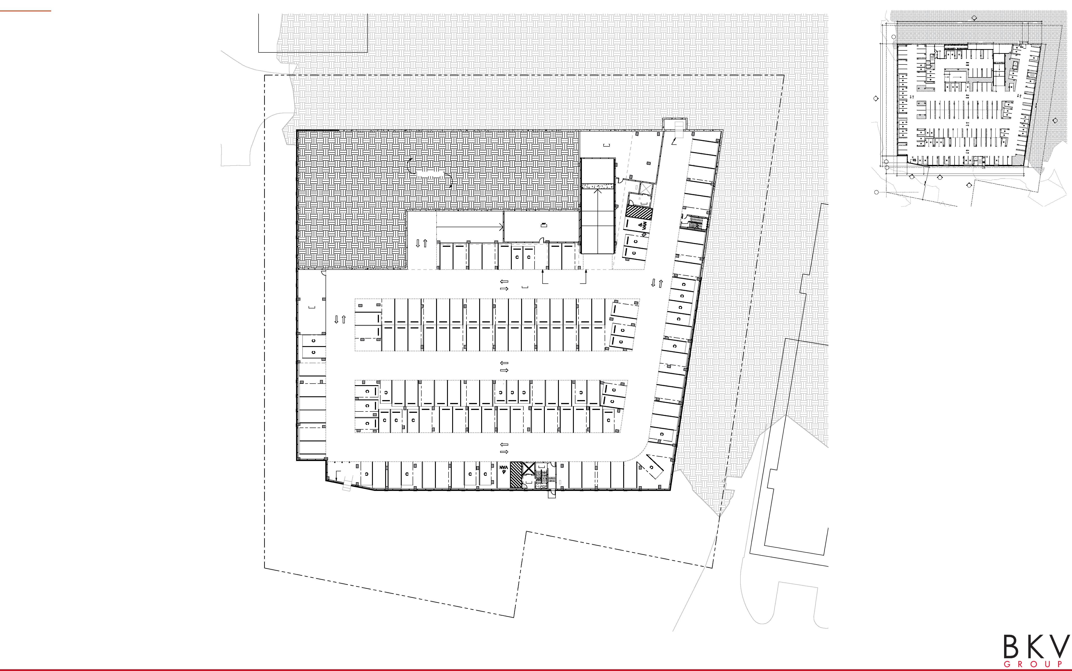
LEVEL P1 TURAL KEYNOTES
PREVIOUS PLAN
292' - 6"
1 A401
37' - 6"
22' -4 5/8" 253' -4 ¹/₈" 12' - 0" 27' -1 ⁷/₈"
1
16' - 7 5/8" 19'- 4 3/8"
51' - 4 5/8"
4' - 0"
BIKE STORAGE
3/4"
WATER SERVICE
ELECTRICAL ROOM ROOM
STORAGE
ELEV. LOBBY C
^{10'03/-}
18' - 4 3/8"
INTAKE
ELEV. LOBBY A
5' -0"
14' - 7 5/8"
ELEV. LOBBY
10' -0"
19
11' - 1 5/8" 18' - 11 ¹/₂" 10' - 0"
10 20
10
DN
DN
1 A402
248' - 0"
6' - 9 ¹/₄" 13' - 9 3/8"227' - 5 3/8"
3 A401
MEP M-051
GARAGE INTAKE
1
A
UNEXCAVATED
21'- 9" 20'- 2 5/8" 33'- 11 ⁷/₈"
00 S FOR
202' - 7 ⁷/₈"
256' - 10 3/8"
-
-
-
-
2 A401
ELEV. LOBBY B
012
A
DN
M-050
STAIR B ST-02
UP
PARKING SLAB ON GRADE
P-050
STAIR C ST-03
BIKE STORAGE S-052
GARAGE EXHAUST
ELEV. LOBBY C
014
The Wesley Campus Plan: The Standard at Wesley I 02.11.2025
20

Slide 21
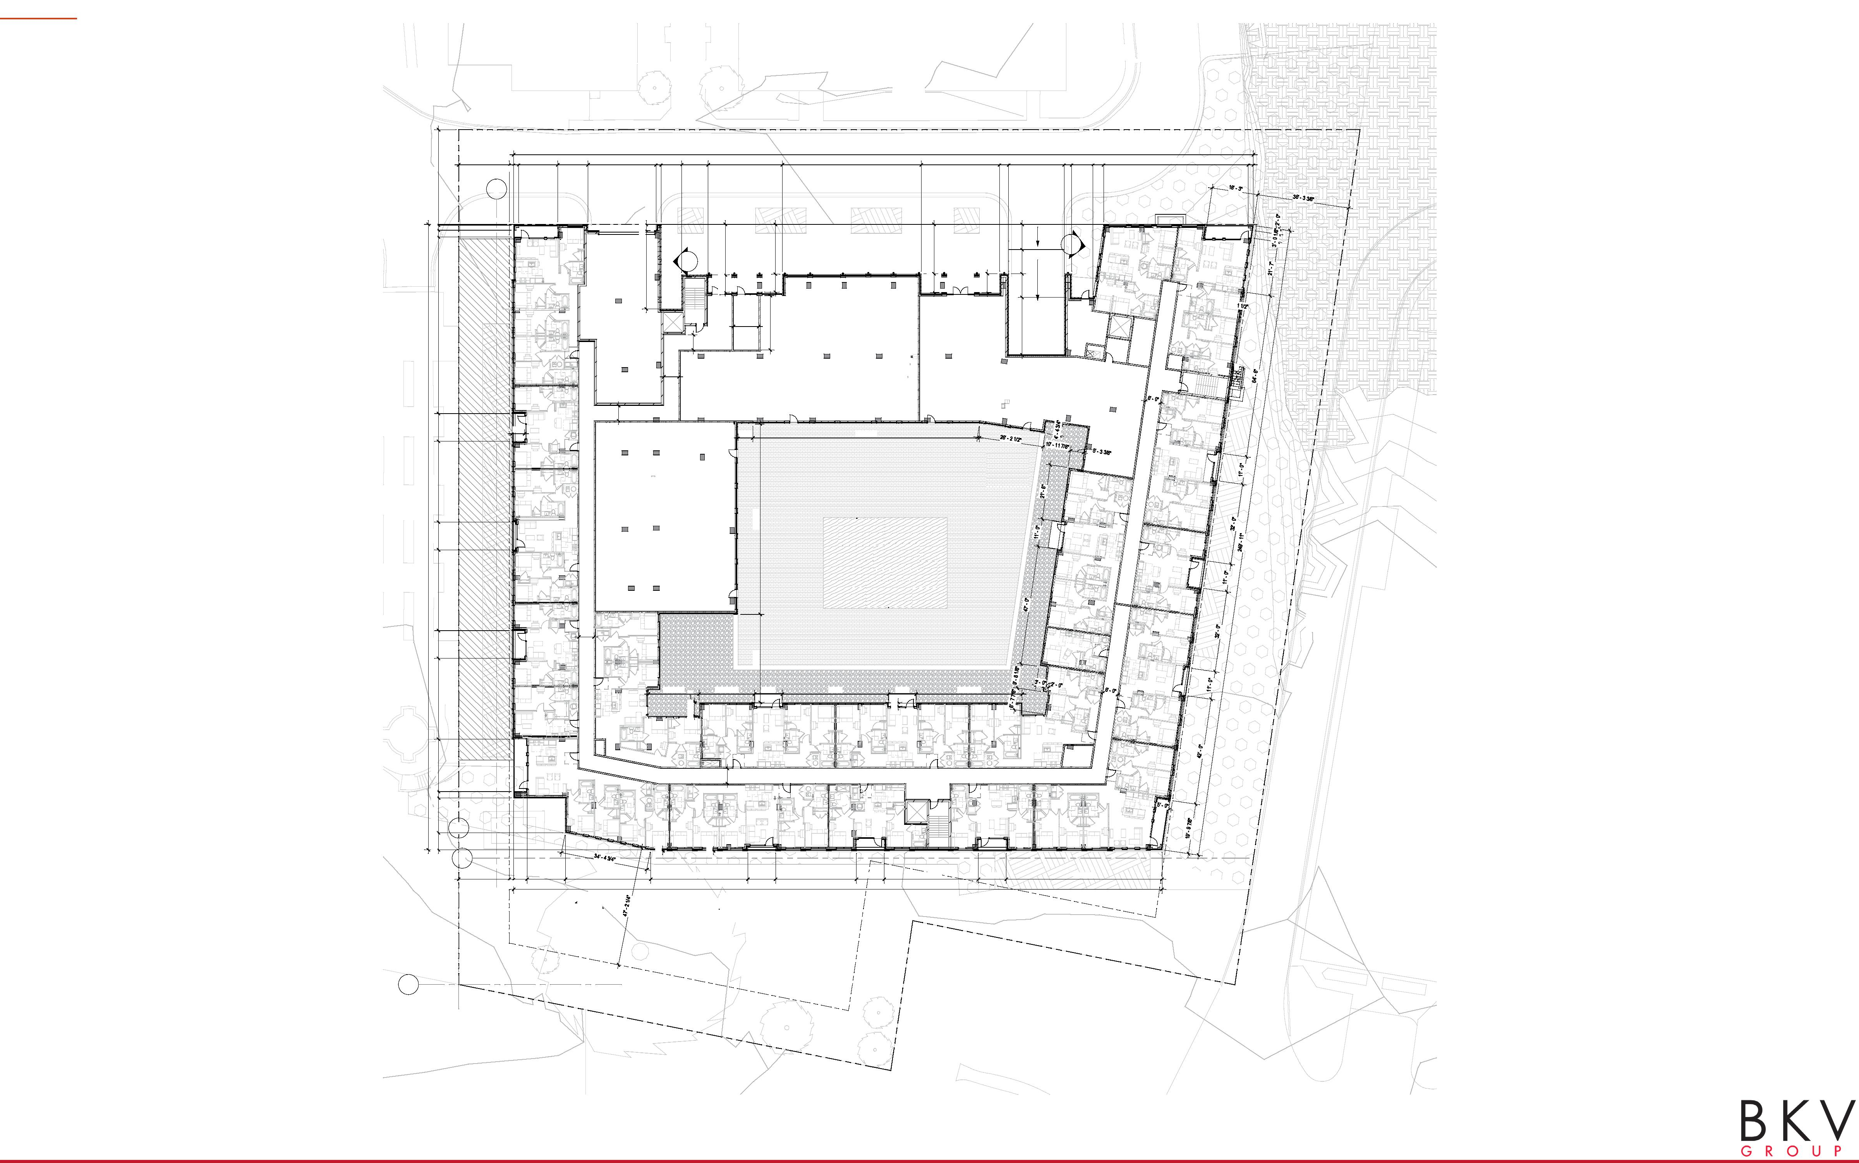
LEVEL 1
292' - 9 3/8"
6' - 8 5/8" 13' - 10" 2' - 5 3/4" 20' - 9 1/4" 32' - 0" 11' - 0" 32' - 0" 11' - 0" 32' - 0" 11' - 0" 69' - 11" 2' - 8 2' 5/8"- 0" 37' - 9 3/8"
- ^{01' 0"}
20' - 0" 2' - 0" 15' - 5 1/8" 12' - 0" 27' - 0" 2' - 0" 10' - 6 1/2" 29' - 4 3/8" 55' - 0" 31' - 0" 3' - 6 7/8" 22' - 0" 2' - 11 1/4" 4' - 2 3/4" 57' - 3 3/8" 2' - 0"
1' - 9" 8' - 0 1/4" 8' - 4 7/8"
1
31' - 0 1/2" 2' - 5 1/2"
- 10 1/2" 20' - 0"
- 2" 19' - 8 1/2"
7' - 5 1/2" 19' - 6 1/2"
22' - 8 7/8" 9' - 4 5/8"9' - 6 1/2"10' - 0"
10
-
-
-
-
7' - 5 1/2"
20
UNIT D2
UNIT B3-ALT
UNIT E2
^{CNR TEE}
LOADING & TRASH
FIRE CONTROL CENTER
AMENITY
LOBBY/LEASING
6' - 0"
21' - 6 1/4"
10' - 0"
6' - 0"
UP
5' - 0"
UNIT B1 A
6' - 0"
5' - 10"
89' - 8 3/8"
UNIT D1 E
UNIT B1 D
247' - 8 5/8"
UNIT D1 A
FITNESS
75' - 5 1/2"
UNIT E1 B
UNIT B1 B
6' - 0"
34' - 10"
UNIT S1 A
20' - 0 5/8" _{4"} 21' - 11 1/2" 11' - 0" 42' - 0" 11' - 0" 41' - 11 1/2"
UNIT D1 D
UNIT A2
UNIT E5
5' - 3 1/8"
UNIT D1 B
1' - 6"
MEP
UNIT D1 C
UNIT D3
UNIT D6
6' - 0"
MEP
1
UNIT E1 A
UNIT B2 UNIT B1 C
UNIT E3
A
4 7/8"
1 1/2"
20' - 0"
5' - 4" 15' - 2"
33' - 8 3/4"
38' - 5 1/2"
11' - 0"
32' - 0"
11' - 0"
37' - 3 1/4"
11' - 0"
61' - 7 7/8"
1' - 9"
256' - 7 3/8"
A
The Wesley Campus Plan: The Standard at Wesley I 02.11.2025
21

Slide 22
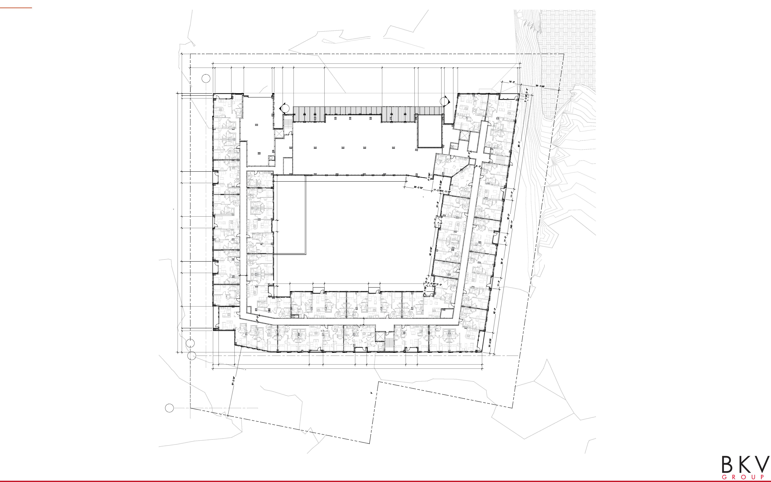
LEVEL 2
292' - 9 3/8"
247' - 5 1/4"
20' - 6 5/8" 2' - 5 3/4" 20' - 9 1/4" 32' - 0" 11' - 0" 32' - 0" 11' - 0" 32' - 0" 11' - 0" 69' - 11" 2' - 8 2' 5/8"- 0" 37' - 9 3/8"
21' - 9" 2' - 0" 15' - 5 1/8" 12' - 0" 27' - 0" 2' - 08"' - 0 1/4" 10' - 6 1/2" 29' - 4 3/8" 55' - 0" 31' - 0" 3' - 6 7/8" 22' - 0" 2' - 11 1/48' - 4 7/84"' - 2 3/4" 57' - 3 3/8" 2' - 0"
1
-
-
-
-
UNIT D2
UNIT B3-ALT
UNIT E2
MEP
MEP
MEP
UNIT A1 A
UNIT B1 A
UNIT S4
126' - 4 1/4"
UNIT A1 B
11' - 0"42' - 9 1/2"
UNIT D1 E
UNIT B1 D
UNIT D1 A
UNIT E1 C
UNIT E1 B
UNIT B1 B
52' - 0"
UNIT S1 A
6' - 0"
4' - 8 1/8" 15' - 4 1/2" 21' - 11 1/2" 11' - 0" 42' - 0" 11' - 0" 41' - 11 1/2"
UNIT D1 D
UNIT A2
UNIT E5
10' - 1"
MEP
UNIT D1 B
UNIT D1 C
UNIT D3
UNIT D6
6' - 0"
MEP
1
UNIT E1 A
UNIT B2 UNIT B1 C
UNIT E3
A
5' - 4"
15' - 2" 71' - 3 3/8" 13' - 3"
30' - 8"
11' - 0"
37' - 3 1/4"
11' - 0"
61' - 7 7/8"
256' - 7 3/8"
A
The Wesley Campus Plan: The Standard at Wesley I 02.11.2025
22

Slide 23
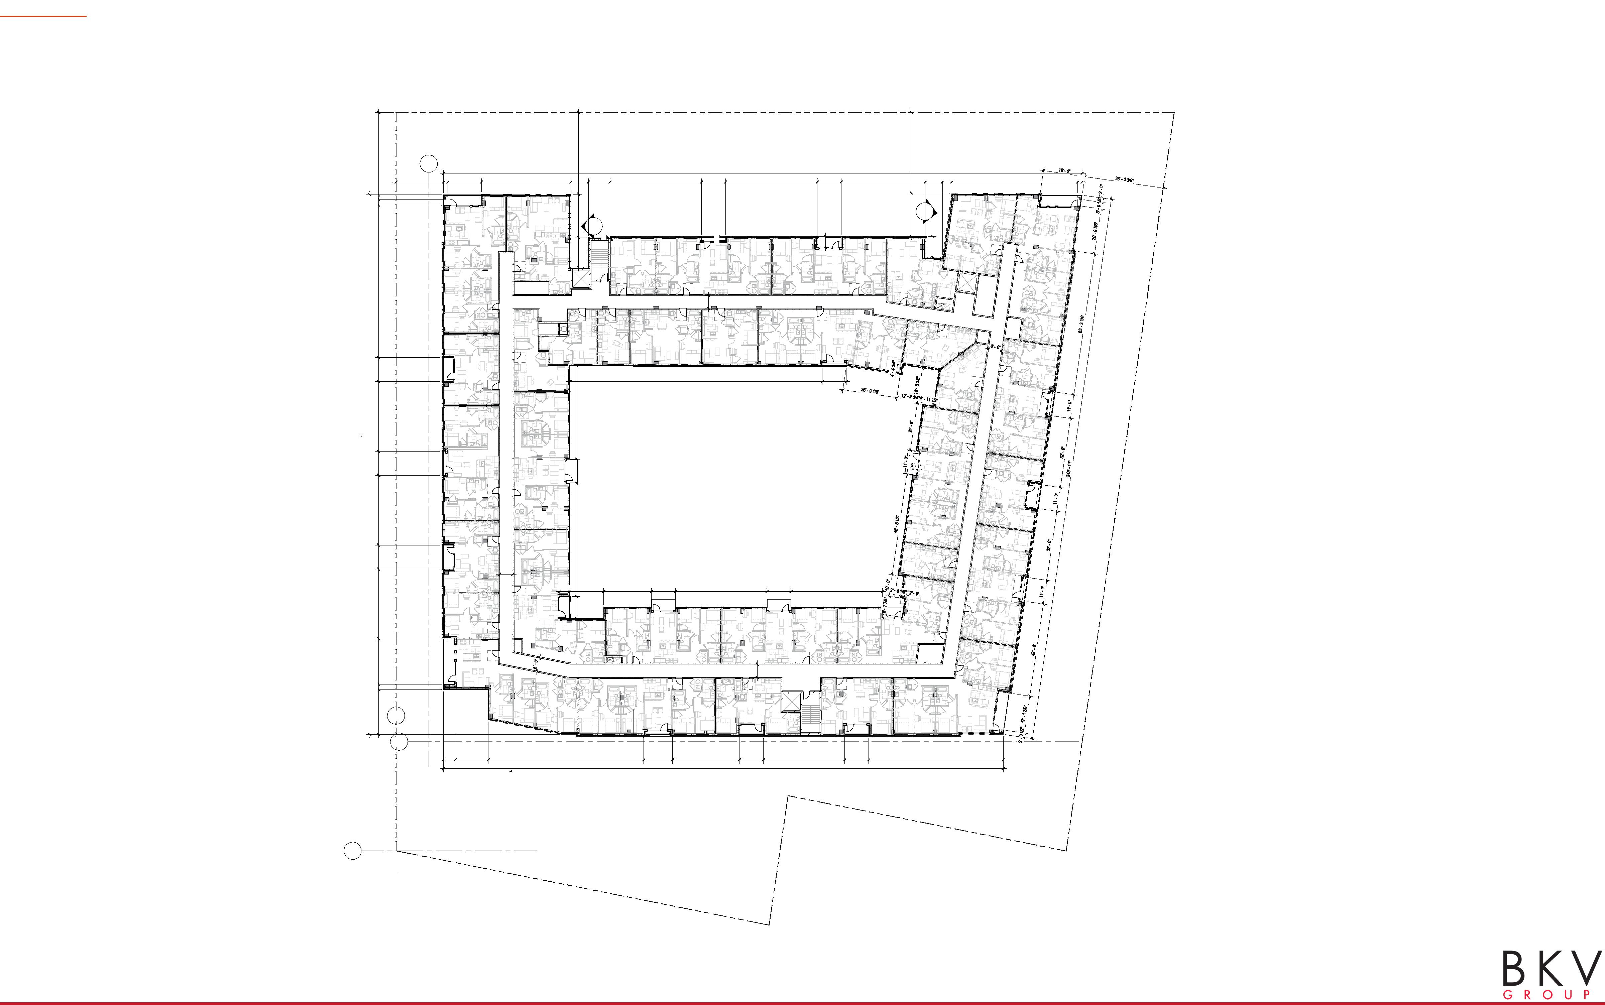
LEVEL 3-5
247' - 5 1/4"
20' - 6 5/8" 2' - 5 3/4" 20' - 9 1/4" 32' - 0" 11' - 0" 32' - 0" 11' - 0" 32' - 0" 11' - 0" 69' - 11" 2' - 8 2' 5/8"- 0" 37' - 9 3/8"
1
37' - 6"
36' - 11 7/8"
21' - 9" 2' - 0" 15' - 5 1/8" 41' - 0" 8' - 0 1/4" 9' - 10 7/8" 42' - 0"
292' - 9 3/8"
11' - 0" 42' - 0" 11' - 0" 38' - 6 1/8"
7' - 10 7/8"4' - 3 5/8" 57' - 8 1/2" 2' - 0"
UNIT C1
13' - 9 3/8" 20' - 0"
-
-
19' - 10 1/8"
-
-
UNIT D2
UNIT B3-ALT
8"
2' - 0"
5' - 0"
9' - 7 1/8"
UNIT E2
UNIT A2 B
UNIT D1 G
UNIT D1 F
UNIT A5-ALT
MEP
6' - 0"
MEP
UNIT A4 UNIT S1 B
UNIT B1 E UNIT A6-ALT
UNIT E4
UNIT A1 A
MEP
UNIT B1 A
UNIT A3
115' - 7 7/8"
11' - 0"
UNIT A1 B
11' - 0"42' - 9 1/2"
UNIT D1 E
UNIT B1 D
UNIT D1 A
UNIT E1 C
UNIT E1 B
UNIT B1 B
52' - 0"
UNIT S1 A
6' - 0"
4' - 8 1/8" 15' - 4 1/2" 21' - 11 1/2" 11' - 0" 42' - 0" 11' - 0" 41' - 11 1/2"
UNIT D1 D
UNIT A2
UNIT E5
10' - 1"
MEP
UNIT D1 B
UNIT D1 C
UNIT D3
UNIT D6
6' - 0"
MEP
1
UNIT B2 UNIT B1 C
UNIT E3
A
5' - 4"
15' - 2"
71' - 3 3/8"
UNIT E1 A
13' - 3"
30' - 8" 11' - 0"
37' - 3 1/4" 11' - 0"
61' - 7 7/8"
256' - 7 3/8"
A
The Wesley Campus Plan: The Standard at Wesley I 02.11.2025
23

Slide 24
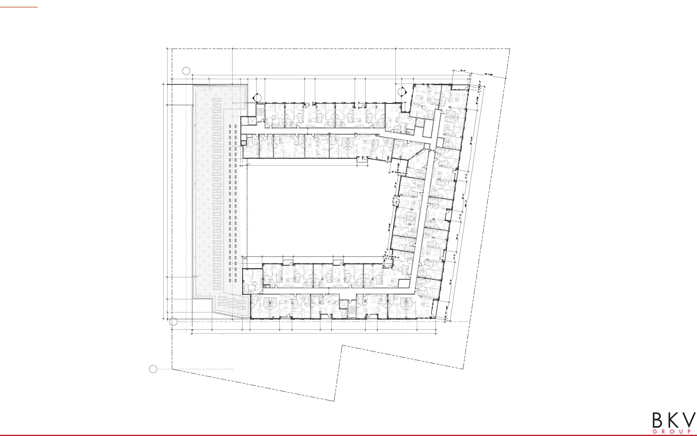
LEVEL 6-7
11 6' 3/8 - 8 5/8" 13' - 10" 23' - 3" 182' - 0" 21' - 7 5/8" 3 3/8" 37' - 6"
1
37' - 6"
36' - 11 7/8"
21' - 9" 17' - 5 1/8" 33' - 1 3/8"
7' - 10 5/8"8' - 11 5/8" 8' - 11 1/2" 42' - 0"
292' - 9 3/8"
11' - 0" 42' - 0" 11' - 0" 38' - 6 1/8"
12' - 2 1/2" 57' - 8 1/2" 2' - 0"
26' - 2 1/2" 27' - 11"5' - 2 5/8"110' - 7 3/8"13' - 3"31' - 8 1/8"13' - 6"11 3/8"19' - 4"
-
-
19' - 10 1/8"
-
-
UNIT D2
UNIT B3-ALT
2' - 0"
5' - 7 5/8"
9' - 7 1/8"
UNIT A2 B
UNIT D1 G
UNIT D1 F
UNIT A5-ALT
6' - 0"
MEP
UNIT S2 UNIT S1 B
UNIT B1 E UNIT A6-ALT
UNIT E4
UNIT A1 A
MEP
1' - 6"
2' - 3 3/8" 5' - 2 1/4" 115' - 7 7/8" 11' - 0"
UNIT A1 B
UNIT D1 E
UNIT B1 D
247' - 8 5/8"
UNIT E1 B
UNIT S1 A
20' - 11 1/2" 21' - 11 1/2" 11' - 0"
42' - 0" 11' - 0" 41' - 11 1/2"
UNIT D1 D
UNIT S3
UNIT D1 B
UNIT D1 C
UNIT D3
6' - 0"
MEP
UNIT E1 A
UNIT B2 UNIT B1 C
UNIT E3
A
21' - 1" 8" 20' - 6" 31' - 11 1/8"
8' - 3 1/4"
31' - 1 1/8"
13' - 3"
29' - 9"
11' - 11"
35' - 9"
12' - 6 1/4"
42' - 0"
19' - 7 7/8"
257' - 3 3/8"
A
The Wesley Campus Plan: The Standard at Wesley I 02.11.2025
24

Slide 25
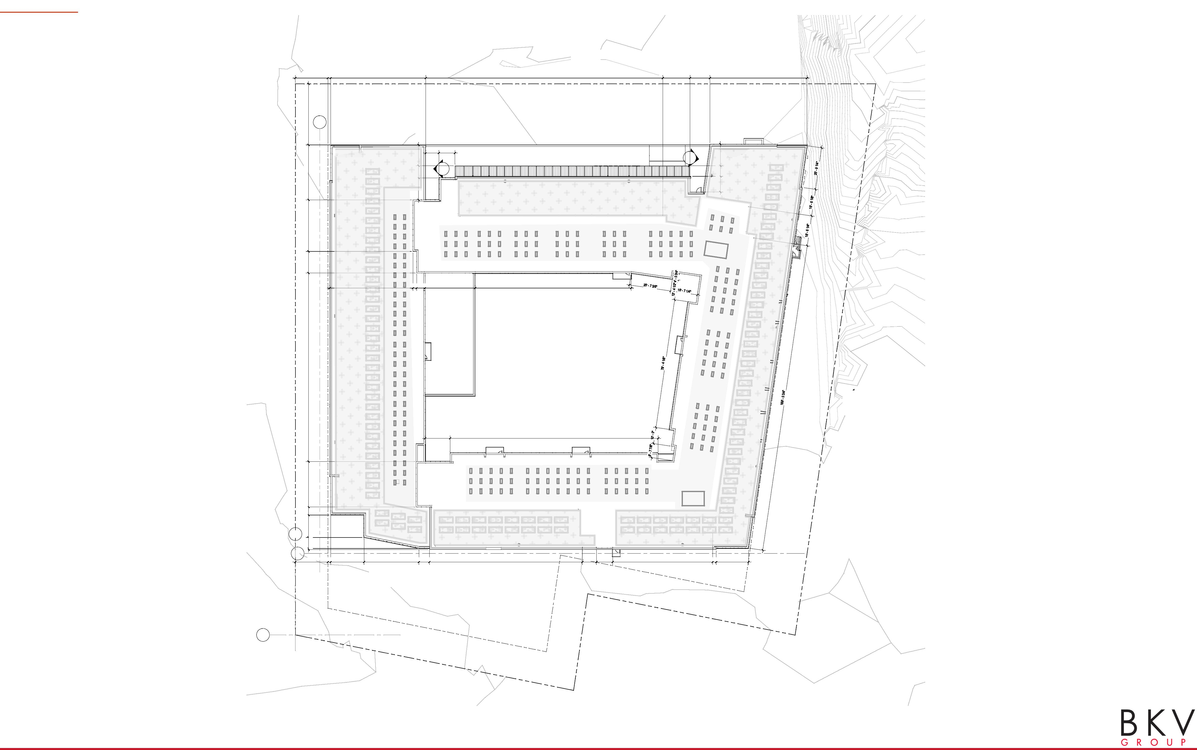
ROOF PLAN
20' - 0" 1' - 9" 58' - 5 3/8" 145' - 7 7/8" 16' - 9 1/8" 12' - 2 1/2" 59' - 8"
13' - 9 3/8" 4' - 11 7/8"27' - 11"115' - 9 7/8"13' - 3"31' - 8 1/8"33' - 9 3/8"37' - 6"
1
13' - 6" 7' - 5 3/4" 12' - 9 5/8"
8' - 0 1/4" 9' - 10 7/8"
-
-
9' - 7 1/8" 6' - 6 3/8"13' - 3 3/4"
-
-
DN
51' - 2 1/2" 2' - 3 5' 3/8"- 2 1/4" 30' - 10"
95' - 10"
5 STORY ROOF BELOW
FITNESS ROOF BELOW
15' - 4 1/2" 127' - 10 7/8"
1
6' - 9 1/4"
A
8"
20' - 0" 1' - 9" 20' - 6"
33' - 8 1/2" 6' - 5 3/4" 94' - 0 1/8"
8' - 7 5/8" 9' - 11 3/4"
61' - 5 5/8" 2' - 2 1/8" 19' - 10 7/8"
A
The Wesley Campus Plan: The Standard at Wesley I 02.11.2025
25

Slide 26
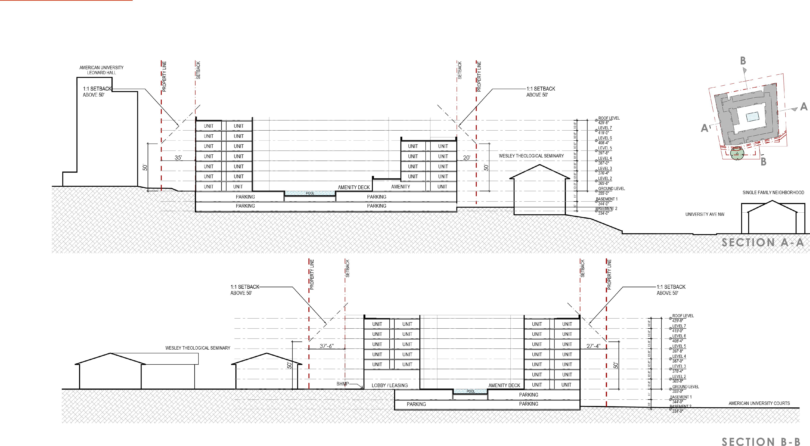
SITE SECTIONS
74'-8"
74'-8"
The Wesley Campus Plan: The Standard at Wesley I 02.11.2025
26

Slide 27
Administration/ maintenance Building Stephen Karcha
2 - Story
5,297 sf
Replaced by Enhanced Landscaping

Slide 28
Green Open Space Stephen Karcha
Demolish Old President’s House, Remove Driveway, Curb Cut and Parking Lot
210,000 + sf
55% Campus Land Area
Long Term Buffer from AU
27 Heritage Trees
76 Special Trees
Enhanced Landscaping
Community Playground

Slide 29
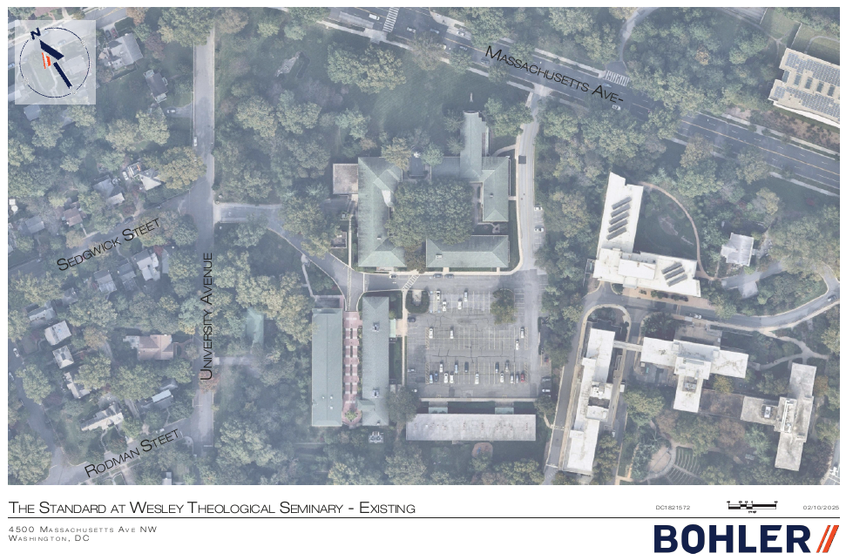

Slide 30
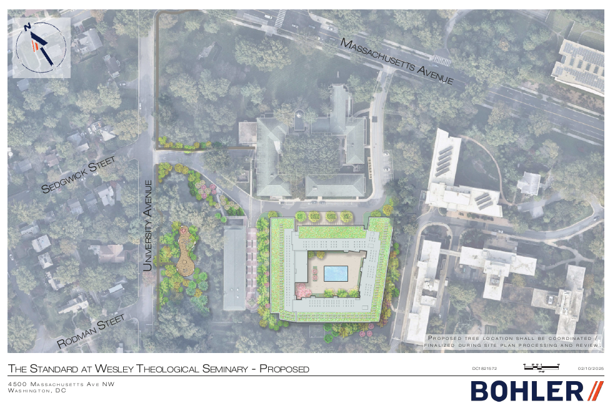

Slide 31
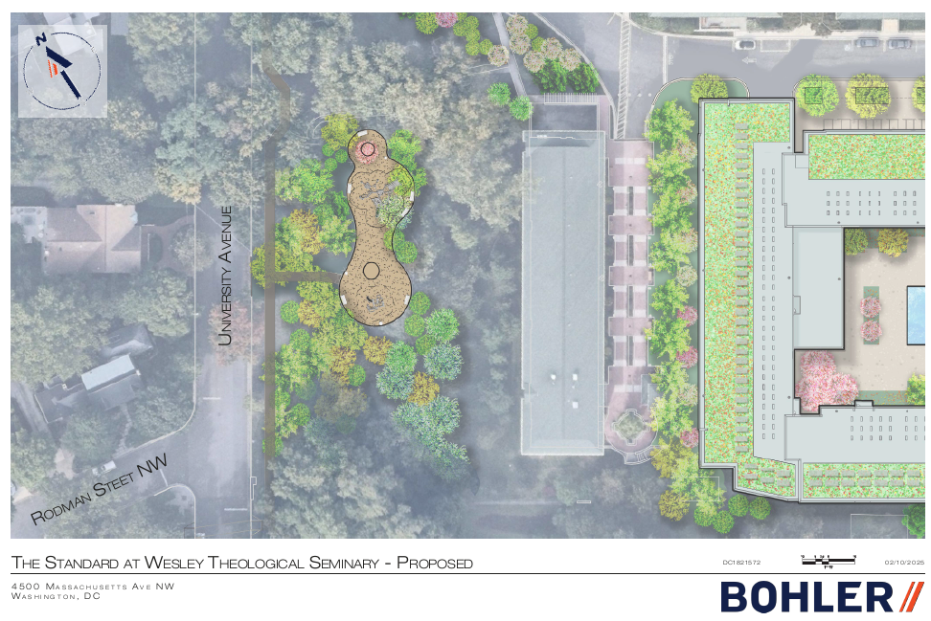

Slide 32
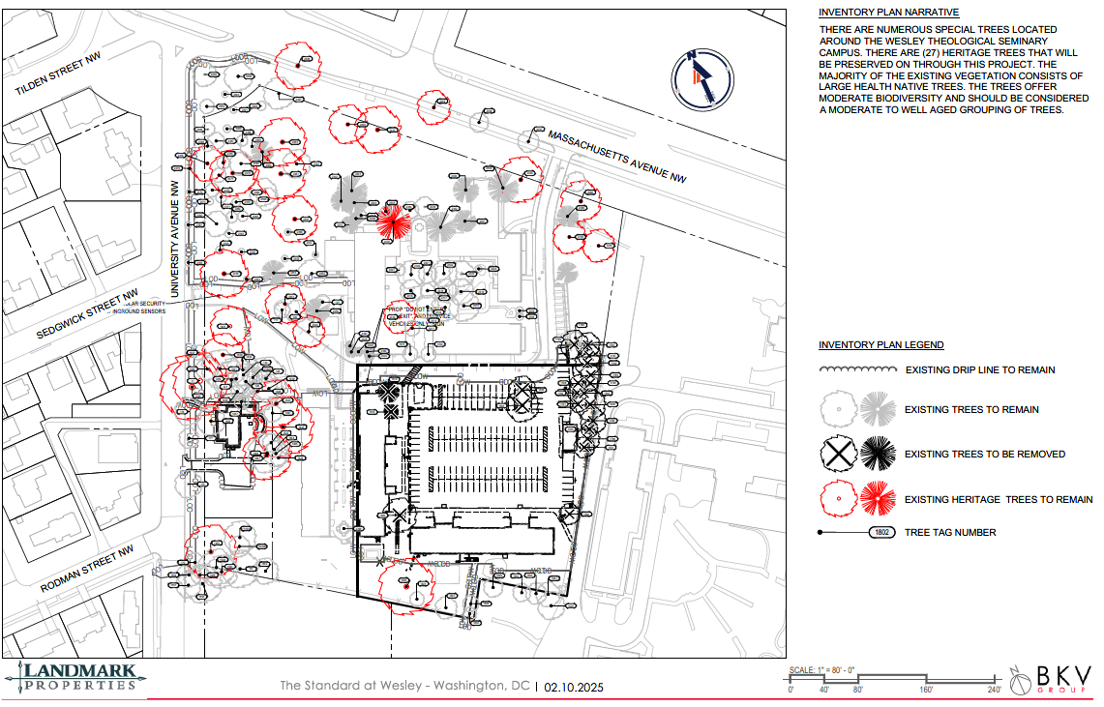
32

Slide 33
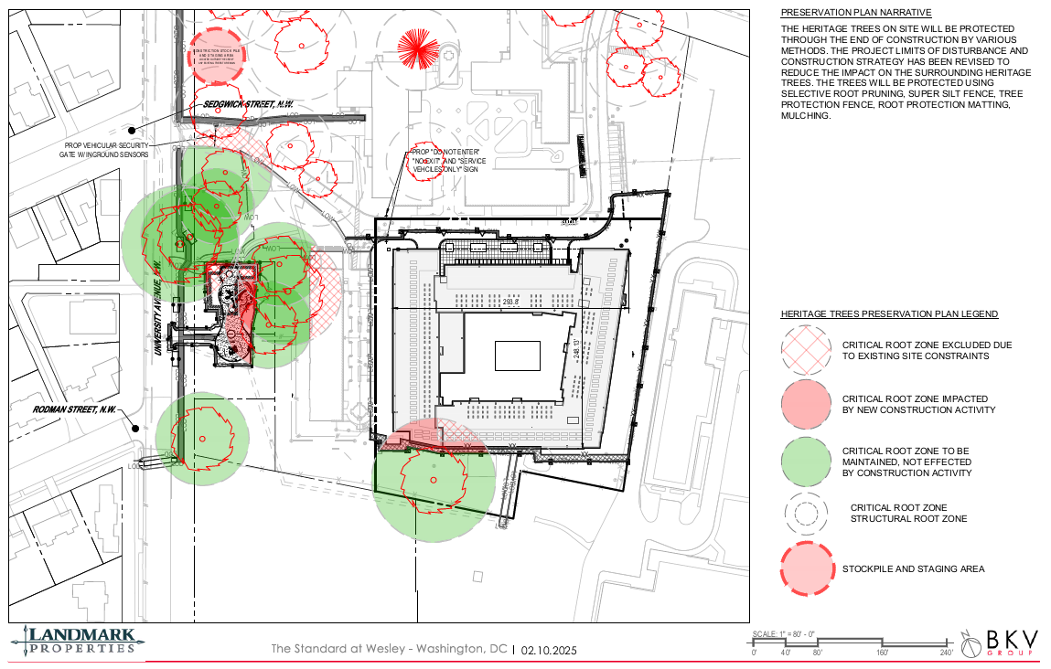
33

Slide 34
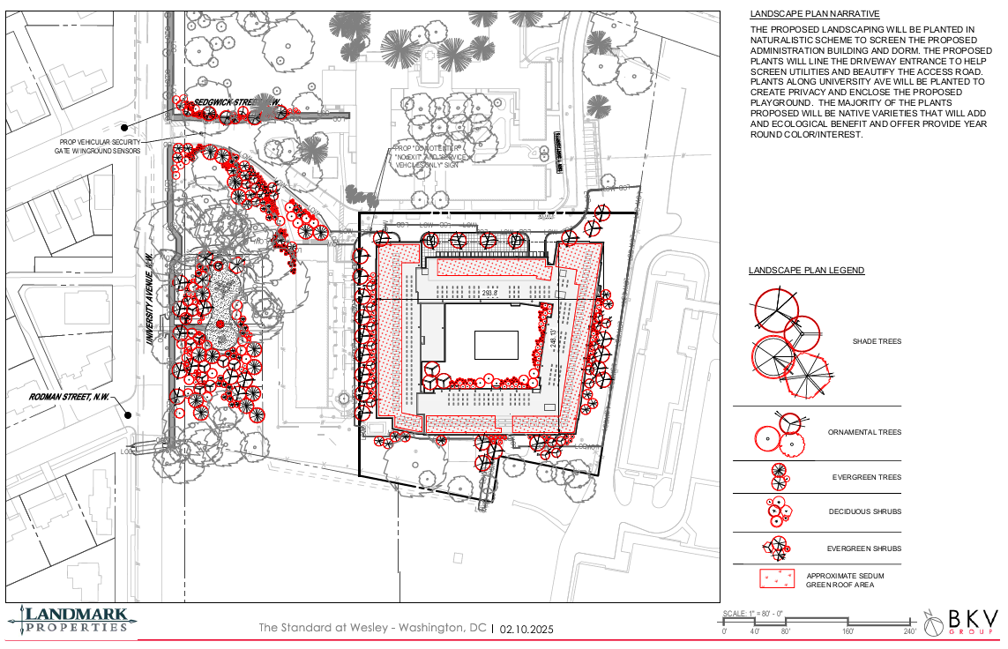
34

Slide 35
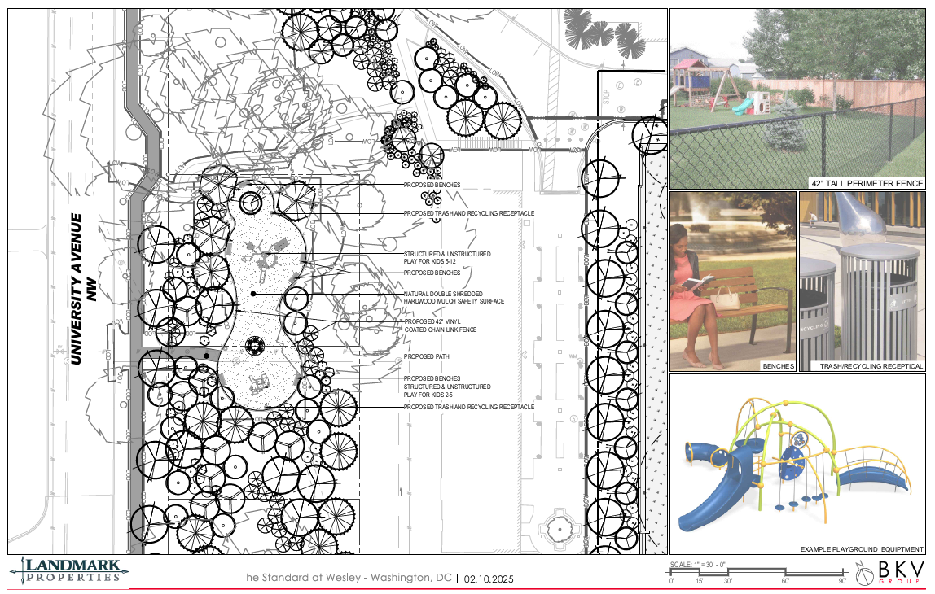
35

Slide 36
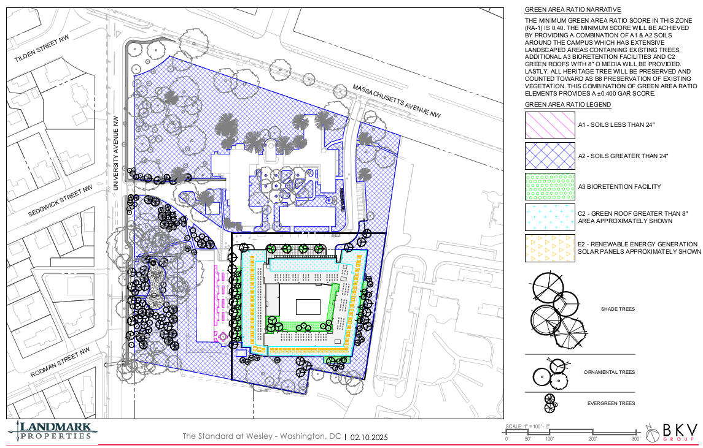
36

Slide 37
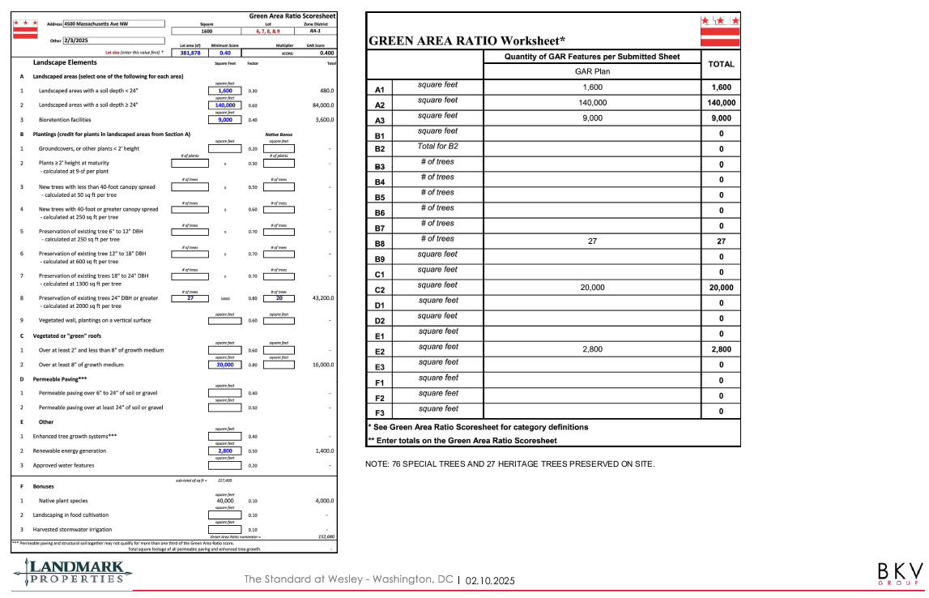
37

Slide 38
Transportation UPDATE William Zeid
295 Underground and Surface Parking Spaces on Campus
Ingress/Egress at Massachusetts Avenue
Limited Service Access at University Avenue with Automatic Barrier
Transportation Demand Management
Performance Monitoring Plan
Sidewalk and Public Space Improvements on University Avenue
19-Dock Capital Bike Share Station
Ride Share Turn Around
Scooter Corral
Limited Traffic and On-Street Parking Impact
On-Street Parking Restrictions/Enforcement
Prohibition on Residential Parking Permits

Slide 39
Summary Housing and Parking Analysis
Existing Wesley Campus
90 beds Active (Carroll Hall and 2014 Dorm)
174 surface parking spaces
Previous Plan
Remove existing 90 beds (Carroll and Straughn) and provide 659 new beds
Remove 143 existing surface spaces, leaving 31 surface spaces
New underground garage with 363 parking spaces
Total of 394 parking spaces onsite
Updated Current Plan
New underground garage with 264 parking spaces
99 fewer spaces than previous plan
New total of 295 parking spaces onsite

Slide 40
WARD 3 Inclusionary Zoning Fund Patrick Brown
Administered by Local Initiatives Support Corporation (LISC)
Ward 3 Only Creation and Preservation of Affordable Housing (Acquisition, Construction and/or Long-Term Financing)
Covenanted Affordability
$8 Million Contribution to Revolving Fund
Equivalent of 11.9% IZ for New Dorm
20% IZ Bonus Not Used
No Reduction for Exclusively Wesley Housing Area

