Slide 1
Thrive in Place Wesley PUD Application Z.C. Case No. 23-08 Campus Plan (2023-2033) Z.C. Case No. 23-08(1) ANC 3D – August 14, 2023 www.wesleyseminary.edu/wesley-masterplan-updates

Slide 2
introduction
Rev. Dr. David McAllister-Wilson
President, Wesley Theological Seminary
John Patrick Brown, Jr., Esquire
Greenstein DeLorme & Luchs, P.C.

Slide 3
Procedural History
Original Campus Plan (22-13).
Zoning Commission Deferred Final Action of Original Campus Plan.
Zoning Commission Invites PUD Application (23-08) and
Refiled Campus Plan (23-08(1)).
PUD and New Campus Plan Incorporate Original Campus Plan.
ANC 3D – September 6 at 7:00pm.
ANC 3E – September 7 at 7:30pm.
Virtual Public Hearing - September 11 at 4:00pm.

Slide 4
AGENDA
Review Site Plan.
Green Open Space.
Building Elevations.
Relationship to AU Buildings.
Updated Landscaping Plan.
Proposed Campus Security Camera Plan.
University and Massachusetts Avenue Views.
Proposed Conditions.

Slide 5
PLAN HIGHLIGHTS
Enhance Green Hilltop Campus Setting, Relationship with Neighborhood.
New Dormitory –Replace beds in Obsolete Dorms (Wesley and AU Students Only).
Inclusionary Zoning (66 beds-13% of new beds).
Maintain and Enhance 210,000 sf. of Green Open Space.
New Campus-wide Landscaping Plan.
278,000 sf. Unused Campus FAR.
Sidewalk and Public Space Improvements along University Ave.
Replace 3 single-family lots and President’s house on University Ave w/ Green Space and Neighborhood Playground.
Additional Restrictions on Use of University Avenue Exit.
Transportation Demand Management and Performance Monitoring Plan.
Detailed PUD/Campus Plan Conditions.
Belt and Suspenders Accountability with PUD and Recorded PUD Covenant.

Slide 6
LIMITED REQUESTED ZONING FLEXIBILITY
Implement and Manage Wesley and AU Student only Private IZ Program in Lieu of IZ Public Lottery.
Minor Variance Relief from Setback Requirements for “Notch” on the southern property line adjacent to AU.
No Rezoning or Additional Density Requested.

Slide 7
NEIGHBORHOOD AMENITIES
Maintain Long-Term Buffer from AU.
Superior Urban Design and Site Planning for Neighborhood.
Maintain and Enhance Green Open Space for Neighborhood.
Increased On-Campus Housing for Students.
Increased Neighborhood Housing for Non-Students.
Sidewalk and Public Space Improvements on University Avenue.
Limited Use of University Avenue Driveway.
On Campus Meeting Room Made Available for Community Groups.
Neighborhood Playground.
278,000 Square Feet of Unused Campus Development.

Slide 8
PUBLIC AMENITIES
Wesley Thrives in Place as DC Based Religious and Educational Institution.
Support and Enhance Diversity, Racial Equity and Inclusion.
Inclusionary Zoning for Eligible Wesley and AU Students.

Slide 9
Inclusionary Zoning
IZ Set Aside The IZ set aside will exceed the minimum requirement of eight percent of the residential gross floor area of the project. The project will not avail itself of the exemption for Wesley students which otherwise would reduce the amount of IZ units offered.
Participation Eligibility The PUD is proposing a privately administered IZ program which will apply standard IZ affordability restrictions but limit participation to AU and Wesley students who will occupy the dorm. The proposal asks that the standard city, open lottery for participation not apply.
IZ Distribution IZ will generally be applied to beds rather than units so as to ensure distribution among co-living apartments and ensure that IZ beds are not concentrated in a few co-living apartments.
Income/Affordability Standards IZ affordability requirements will apply to the Project; 60% MFI for ten percent of the ground floor area and 50% MFI for beds generated by penthouse habitable space.
IZ Unit Standards IZ units will meet all requirements regarding comparable quality as market rate units.
Department of Housing and Community Development (“DHCD”) Oversight Wesley and/or Landmark will be required to execute and record an affordable housing covenant to memorialize the IZ program details and provide enforceability. These covenants have been negotiated and approved with DHCD in a number of affordable projects in the District. 14 DCMR § 2225.

Slide 10
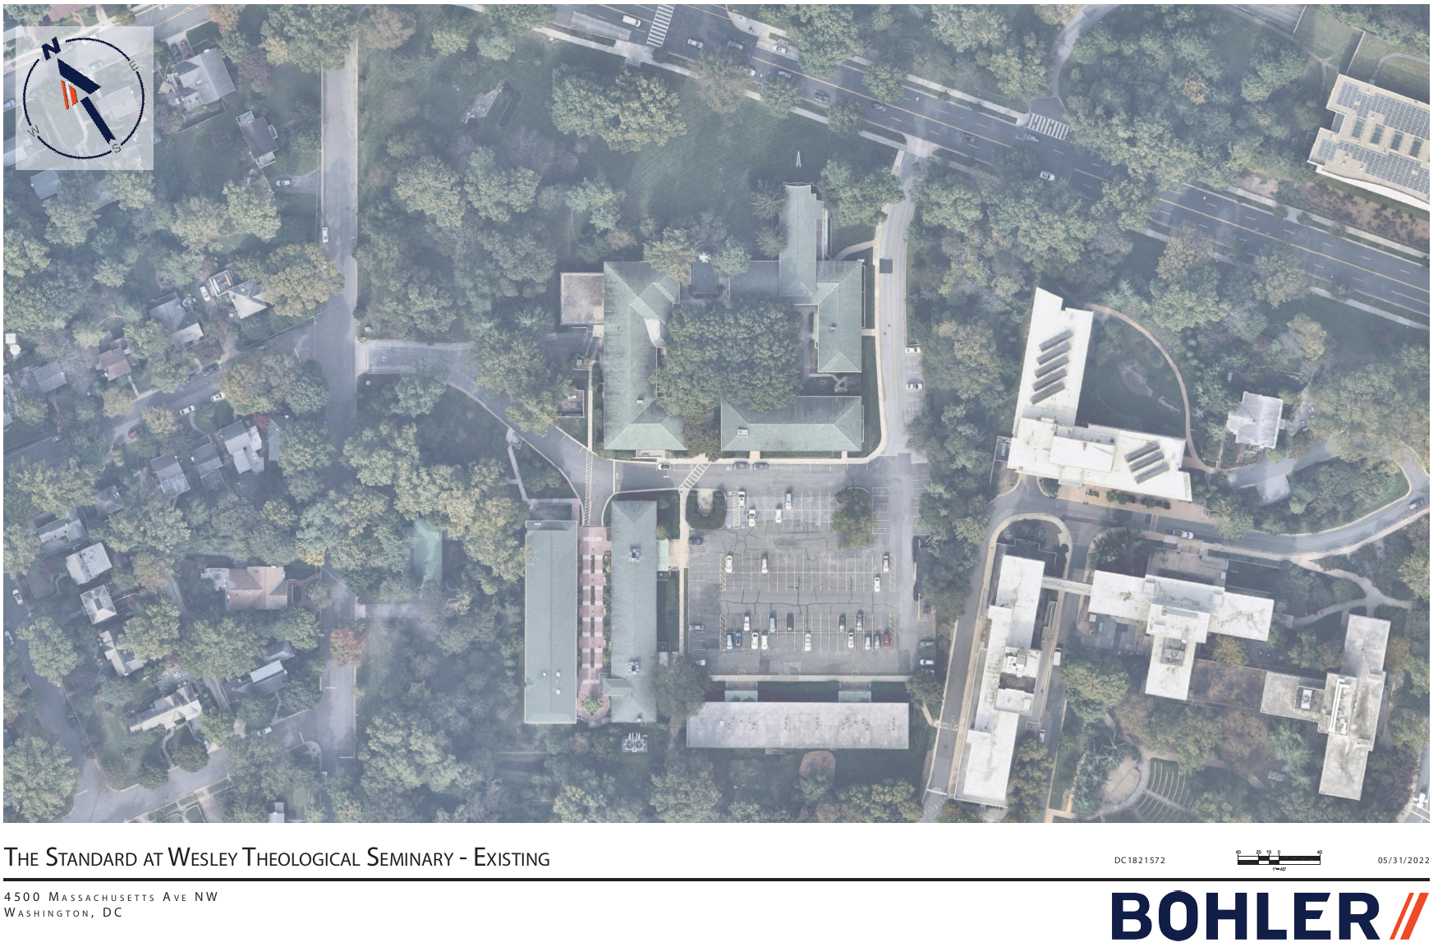
CAMPUS LOCATION
John Patrick Brown, Jr.

Slide 11
CURRENT CAMPUS PLAN

Slide 12
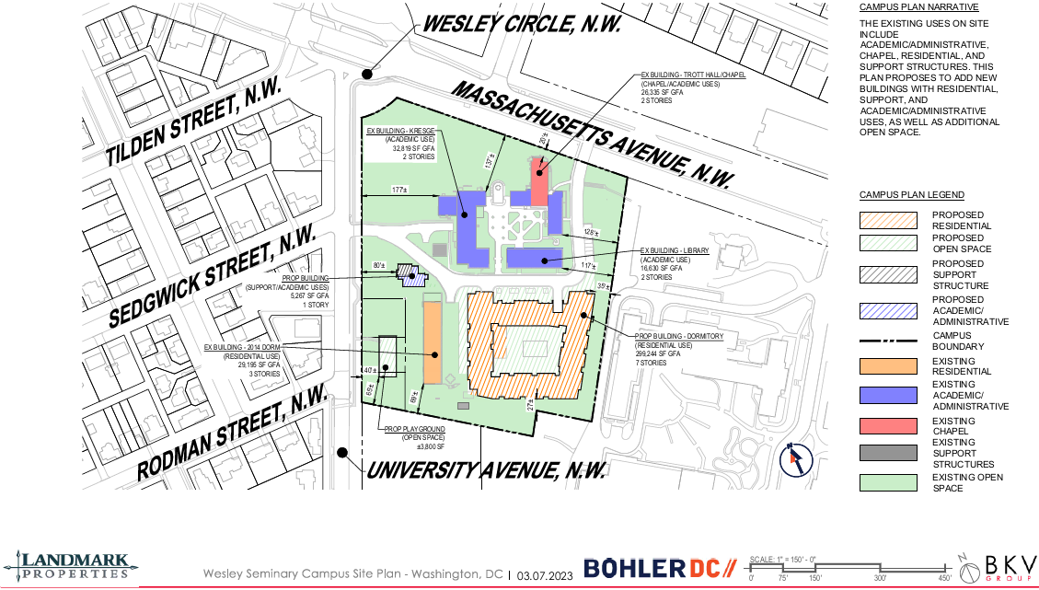

Slide 14
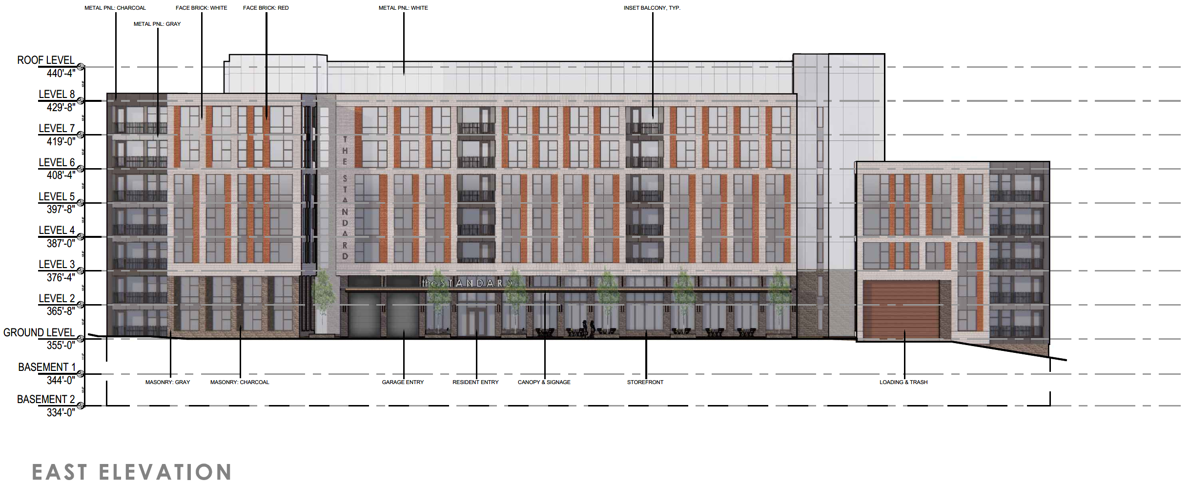

Slide 15
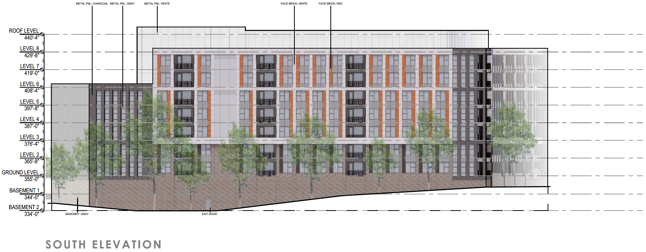

Slide 16
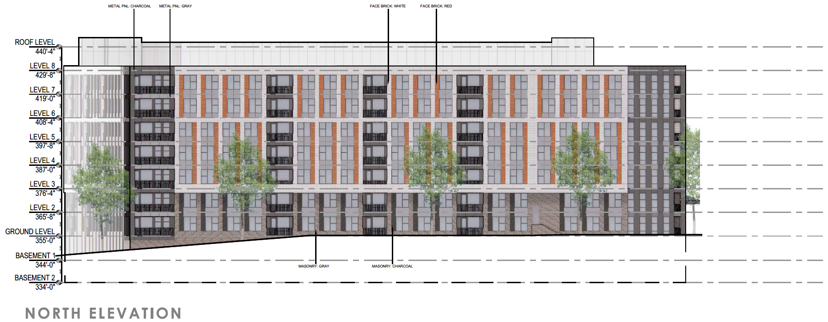

Slide 17
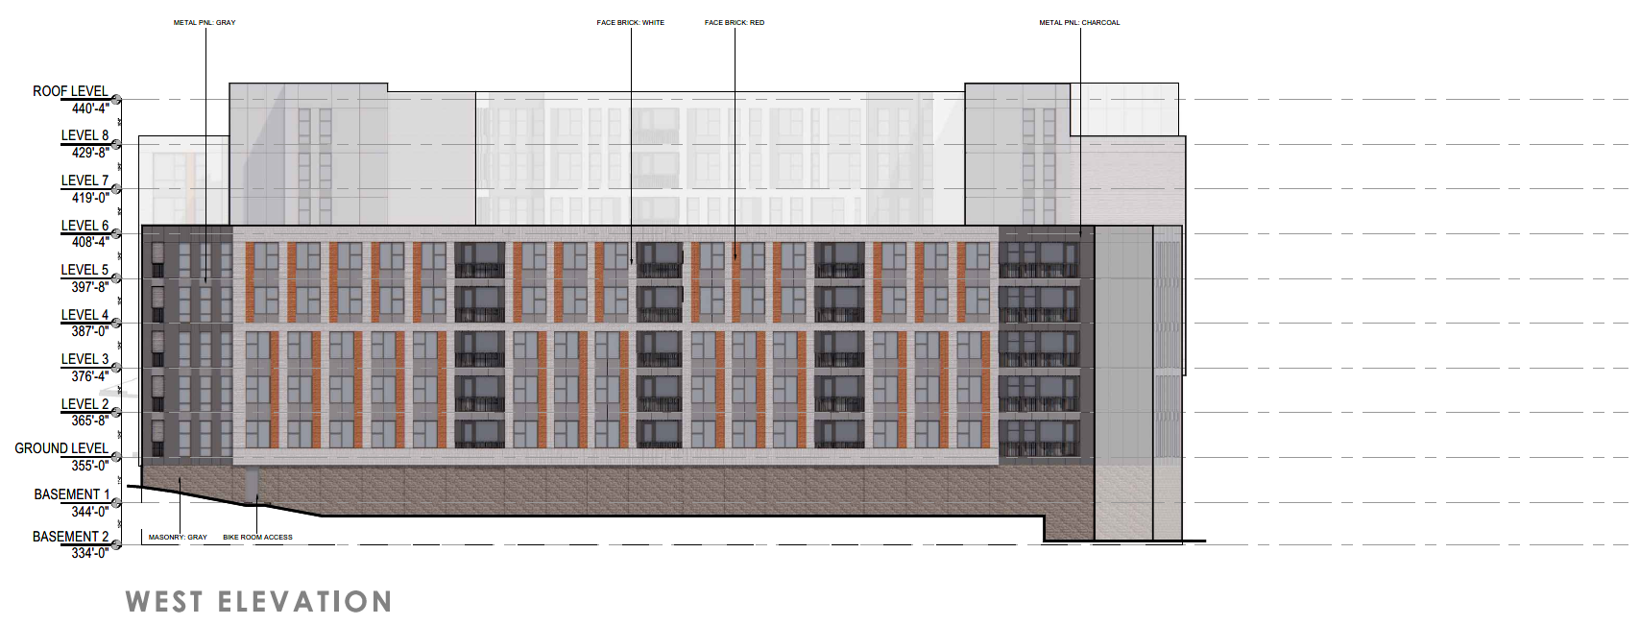

Slide 18
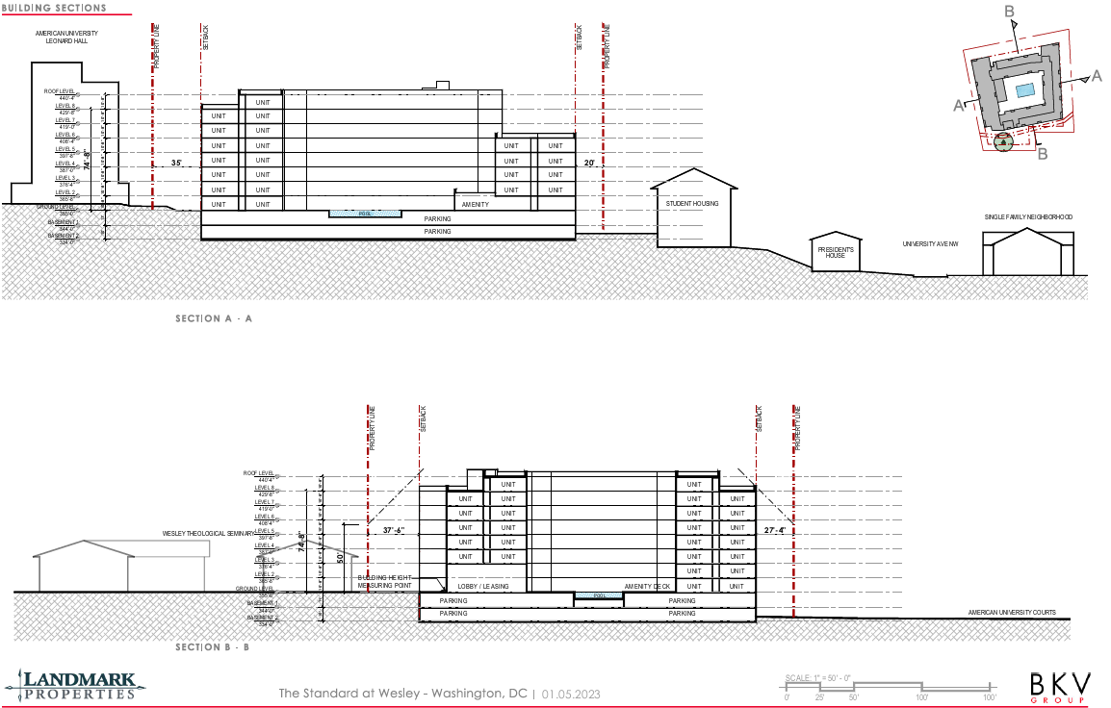

Slide 19
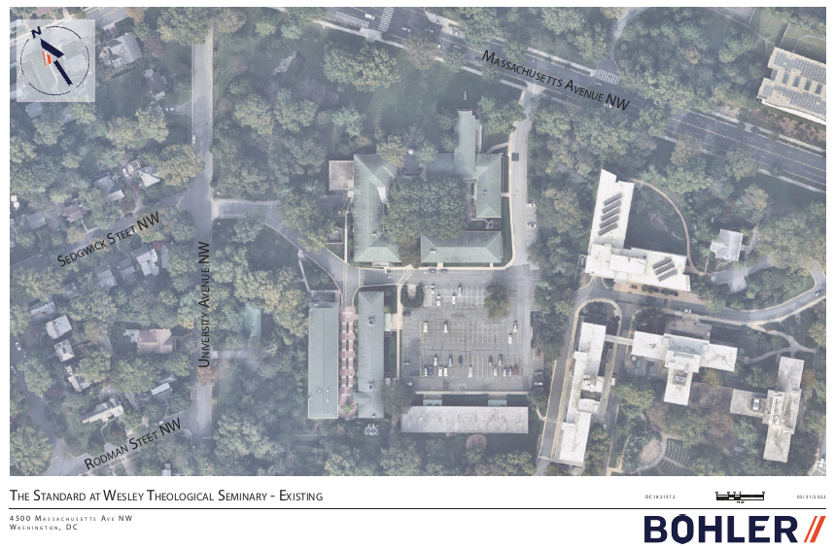

Slide 20
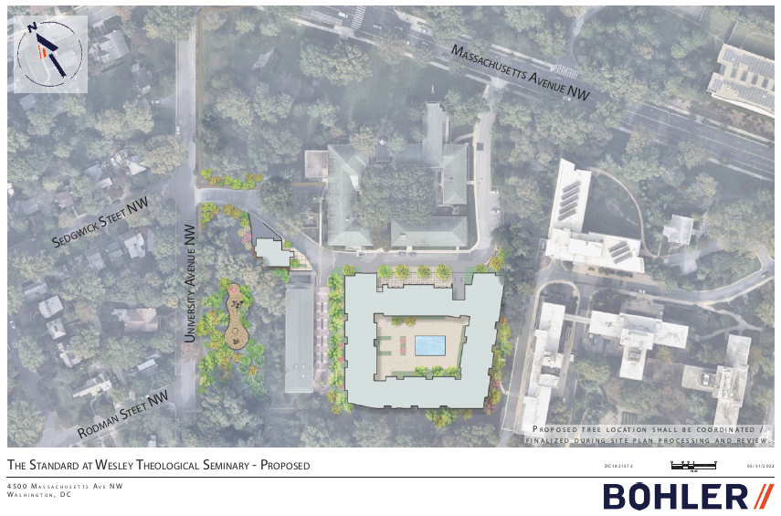

Slide 21
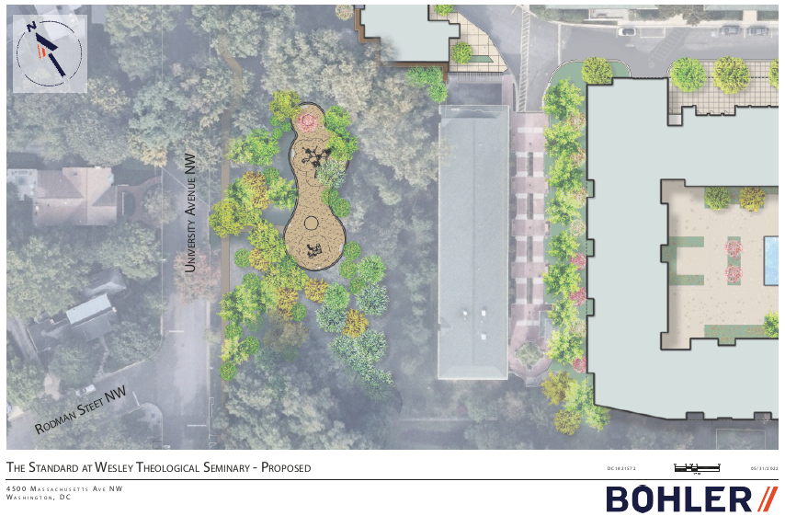

Slide 22
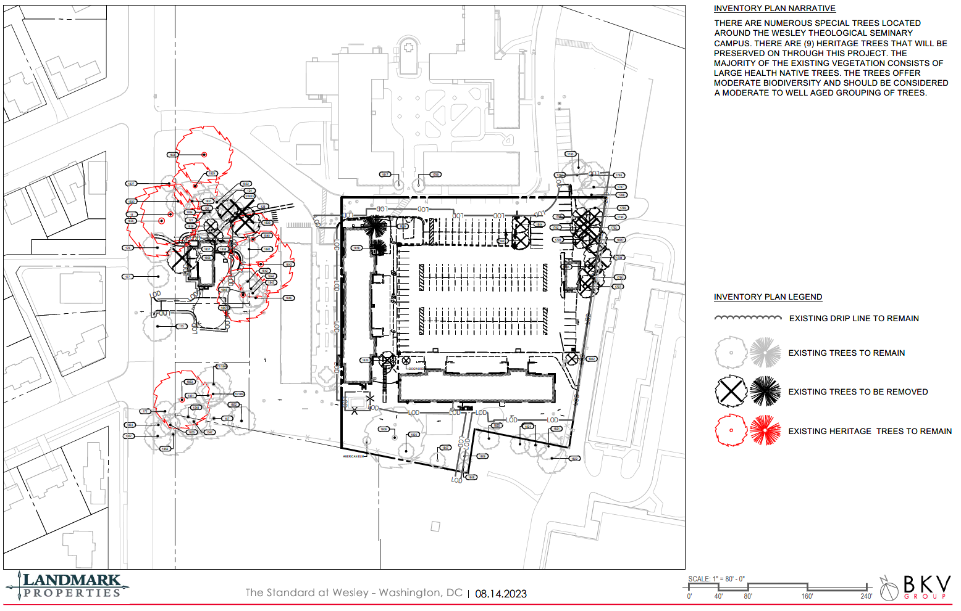

Slide 23
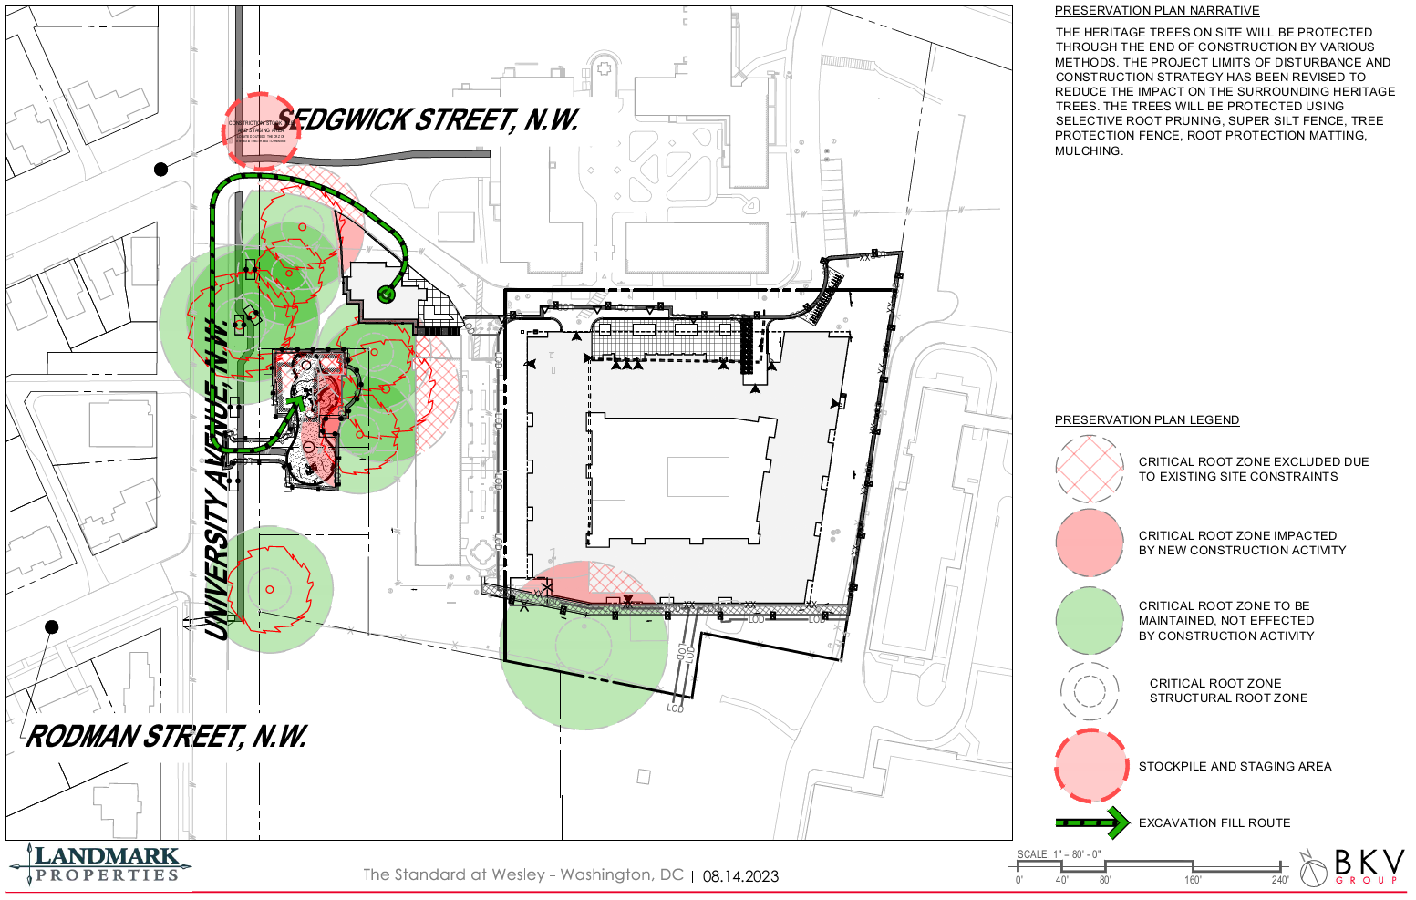

Slide 24
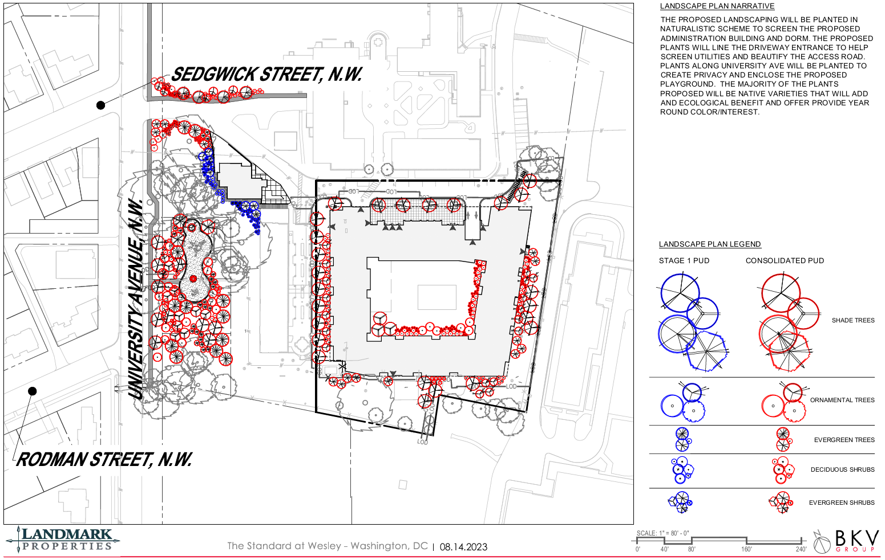

Slide 25
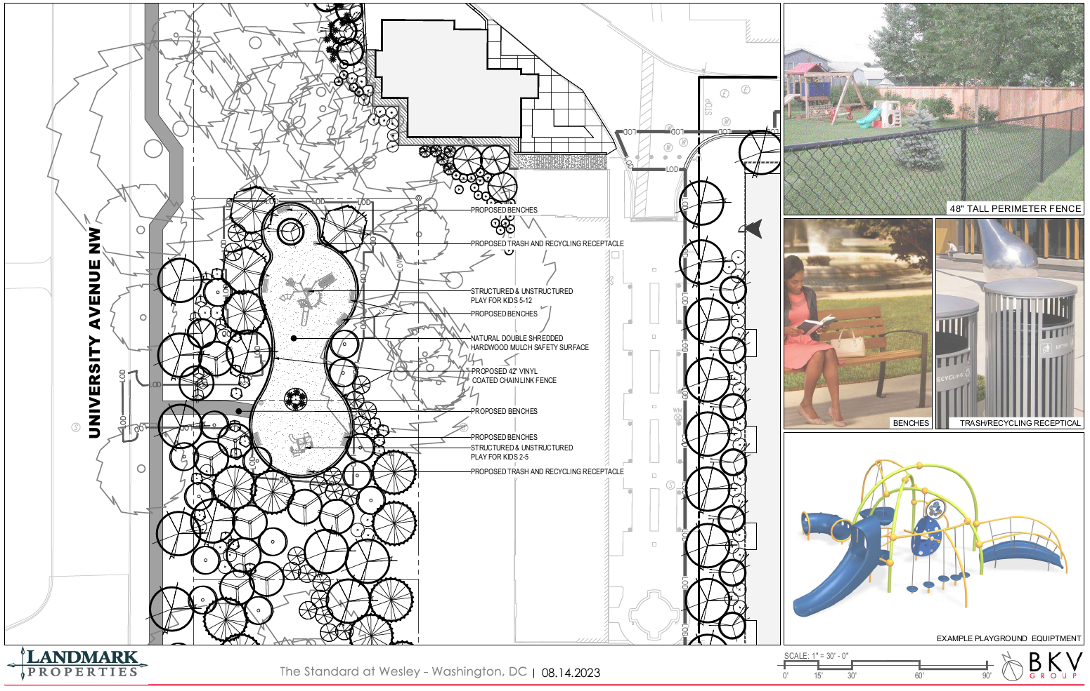

Slide 26
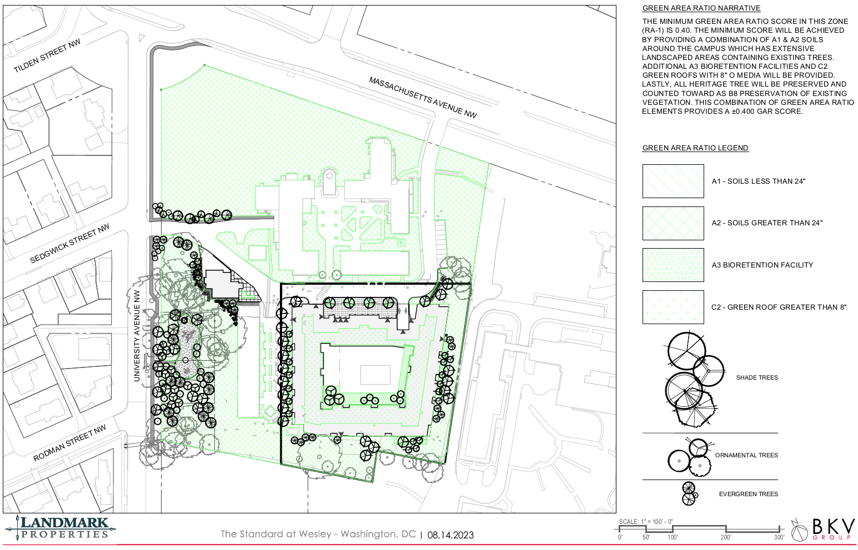

Slide 27
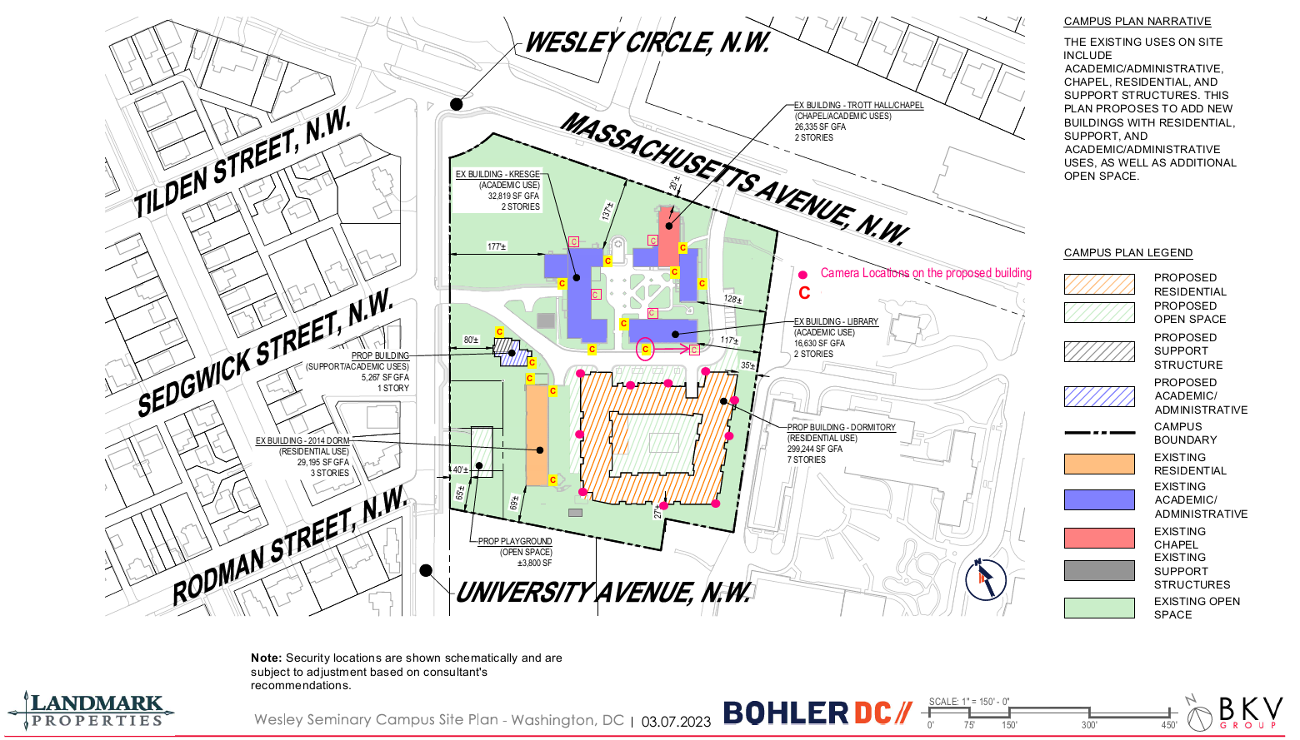
Campus Security Camera Plan

Slide 28
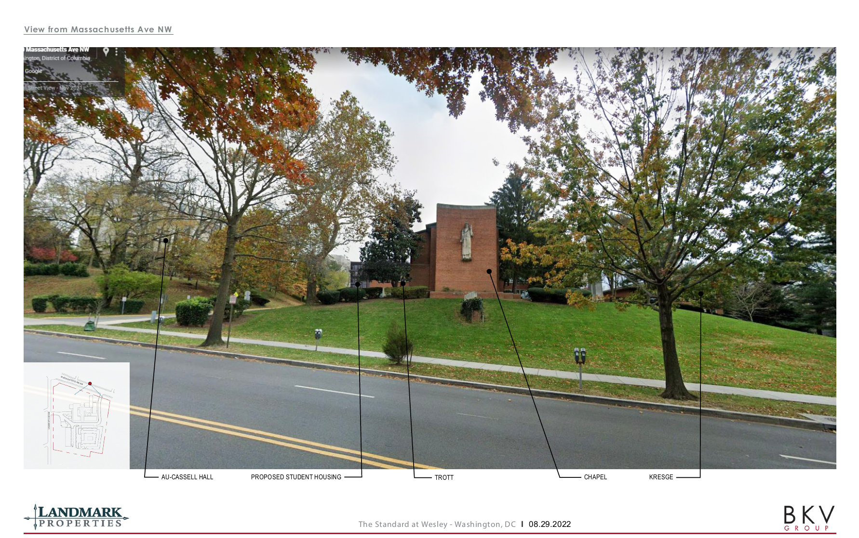

Slide 29
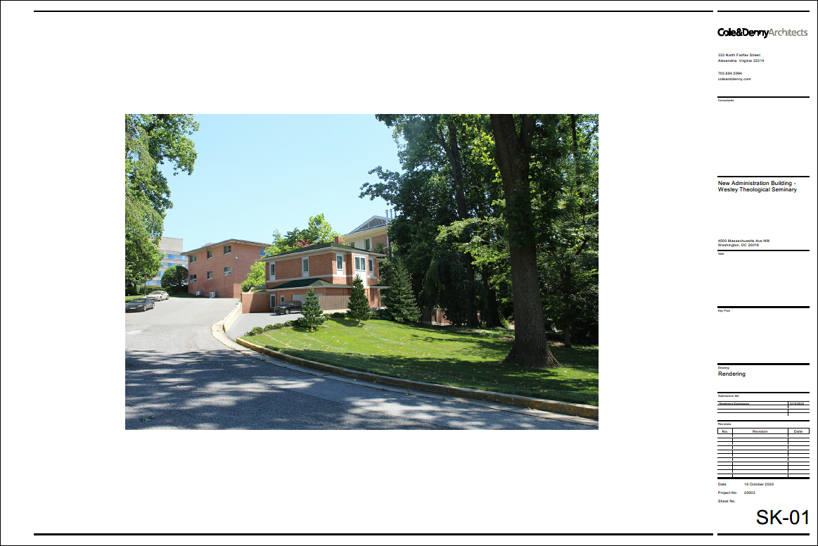

Slide 30
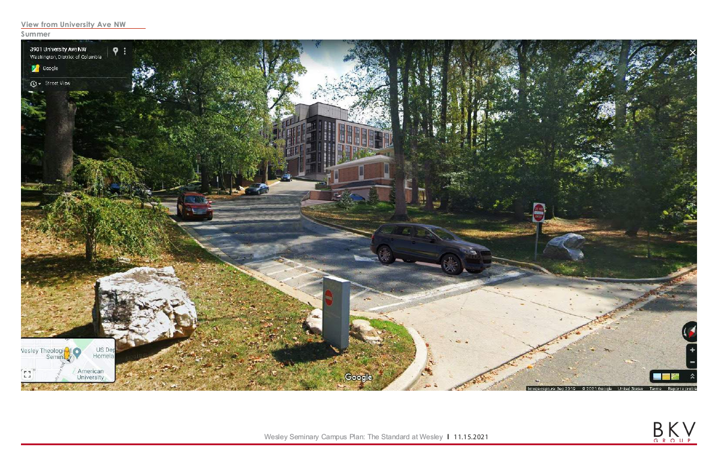

Slide 33
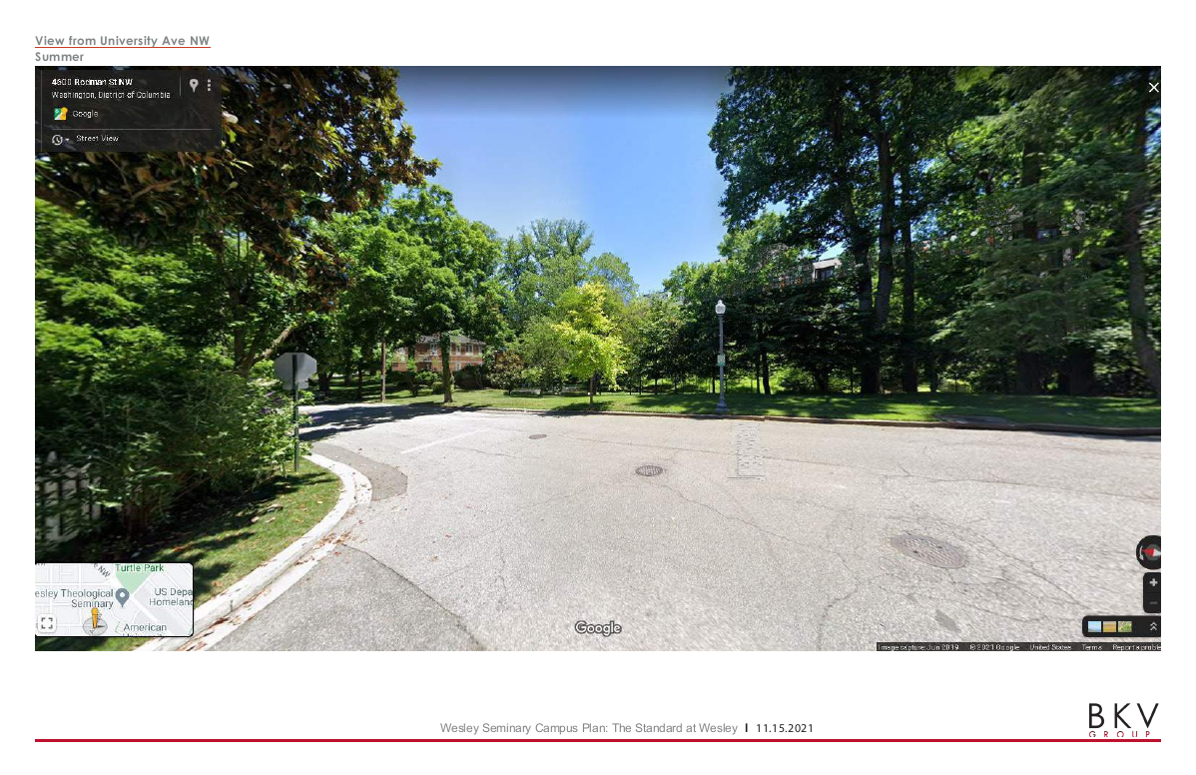

Slide 35
Comprehensive Transportation Review (CTR)
CTR submitted to DDOT on April 29, 2022 with 7-intersection Traffic Impact Analysis
CTR concluded project will not have a detrimental impact with proposed site design elements and TDM measures.
DDOT report supported the CTR findings and recommends TDM commitments to mitigate project impacts, including a new sidewalk along University Avenue between Massachusetts Avenue and Rodman Street.
CTR was approved as part of Zoning Case 23-08, along with a final Transportation Demand Management (TDM) Plan and Performance Monitoring Plan (PMP) for the PUD.

Slide 36
Final TDM Plan and PMP
A Final Transportation Demand Management (TDM) and Performance Monitoring Plan (PMP) memo was submitted to DDOT, satisfying its condition of approving the CTR.
The TDM plan includes the following pedestrian improvements:
A sidewalk along the east side of University Avenue NW between Massachusetts Avenue and Rodman Street, subject to DDOT approval, with a leadwalk into campus along at least one side of the site driveway;
Install signage, crosswalk and ADA curb ramps on the south leg of University Avenue at the Rodman Street intersection, subject to DDOT approval.
Install signage, crosswalk and ADA curb ramps on the east leg of the campus driveway at the University Avenue and Sedgwick Street intersection or construct the crossing as a continuous sidewalk, subject to DDOT approval; and
Install wayfinding signage on the Wesley Seminary campus directing students to the gated connection to the American University campus.
The PMP notes that to be in compliance, the Wesley campus must not generate more than 101 peak hour vehicle trips in either the morning or afternoon peak period.
The current PUD application has no significant changes from the previously approved Campus Plan application.

Slide 37
