Slide 1
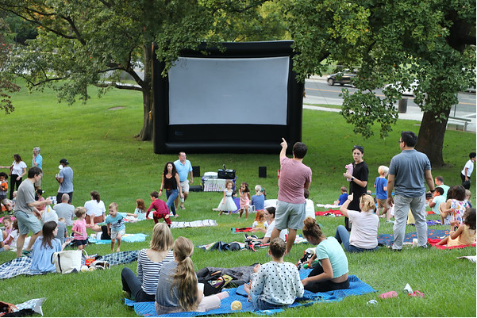
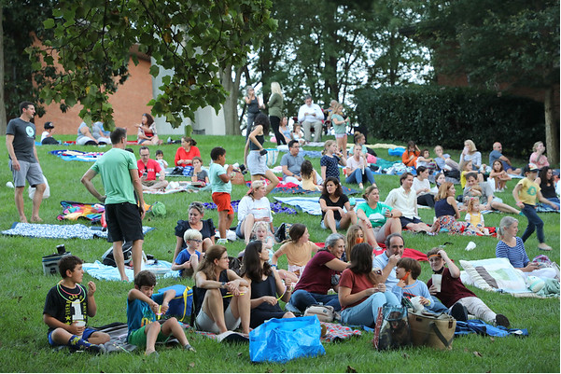
The Wesley Theological Seminary
Proposed Campus Plan 2021 ANC 3D Meeting November 3, 2021
www.wesleyseminary.edu/wesley-master-plan-updates

Slide 2
Elements of Campus Plan
Demolish Old President’s House and Restore Site with Landscaping.
Demolish Carroll and Straughn Halls and Surface Parking Lot.
New Student Housing for Wesley and AU.
New Residential Style/Scale Admin/Faculty/Maintenance building.
No Development of University Avenue Residential Lots.
Maintain “Hill Top” Campus.
Maintain and Enhance Green Buffer Zone on University Avenue and Massachusetts Avenue.
263,000 Square Feet of Unused Gross Floor Area.
Community Playground and other Potential Enhancements. (?)

Slide 4
Green Area Community Buffer
Demolish Old President’s House.
Remove Driveway, Curb Cut and Parking Lot.
Replace with Landscaping Green Open Space.
105-171 ft. to the University Avenue East Curb.
139-205 ft. to the University Avenue West Curb.
300 ft. from New Dormitory to University Avenue East Curb.
55 % of Campus Area Green Open Space.
210,000 Square Feet of Green Open Space.
Green Area Ratio Exceeds Requirements.

Slide 6
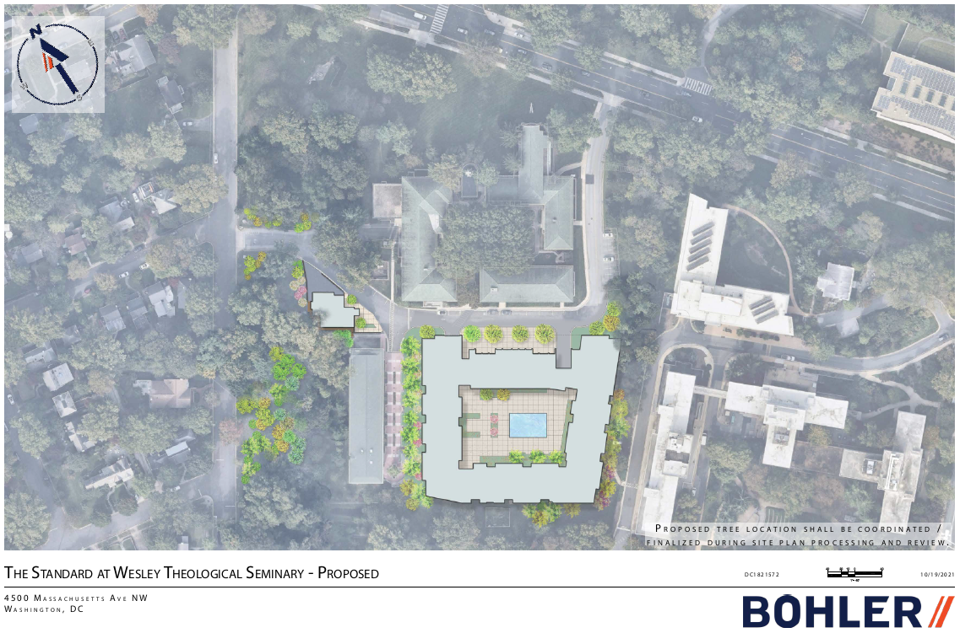

Slide 9
Proposed Student housing
For Wesley and AU Students ONLY.
7 Stories, plus Penthouse.
75 Feet, 8 Inches in Height.
679 Beds (Net 589 New Campus Beds).
Increased Top Level Setbacks to Decrease Visibility from University Avenue.
219 Units Configured in 1, 2, 3, 4, and 5 Bedroom Units.
High Quality Dormitory Design, Amenities and Operations.
2 Levels of Parking with between 300-350 Spaces (including 105 Wesley Replacement Spaces).
Sustainability.

Slide 10
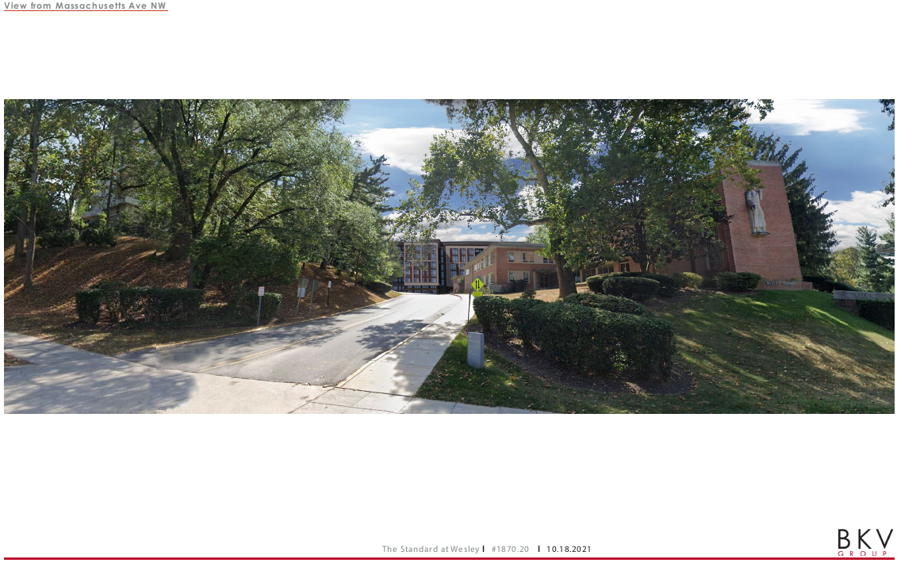

Slide 11
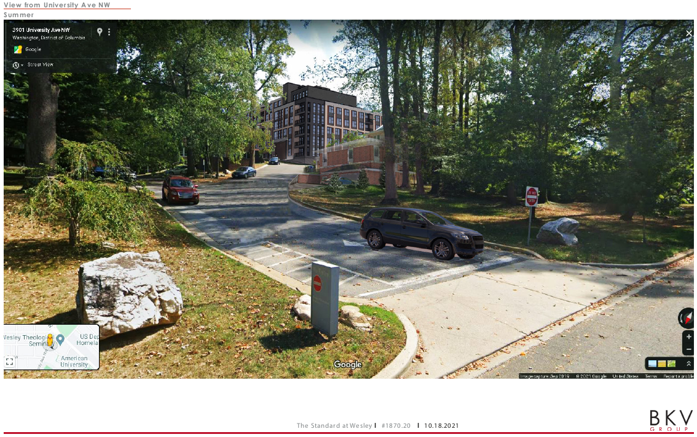

Slide 12
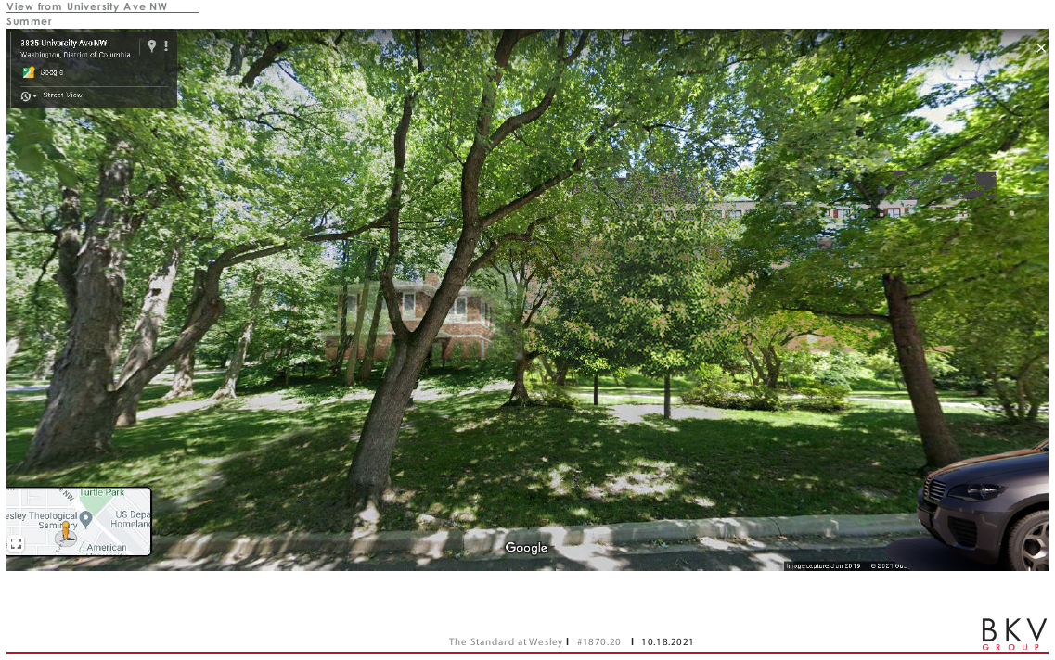

Slide 13
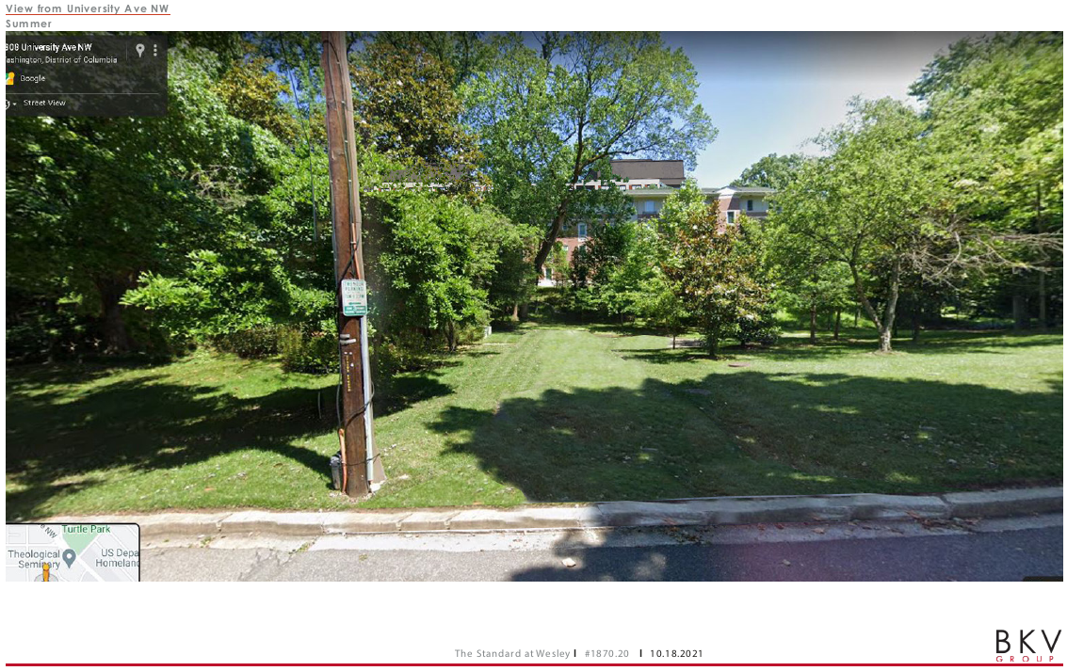

Slide 14
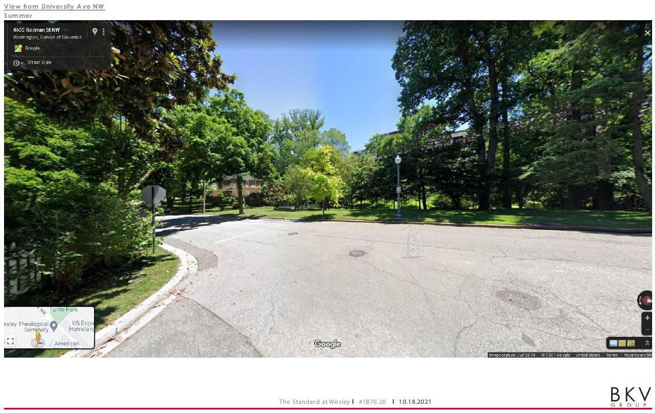

Slide 15
Traffic Update
Objective - Limit University Avenue Access.
Restrict University Avenue Exit.
Maintain No Left Turn From University Avenue Exit.
Maintain Right Turn Only From Massachusetts Avenue Exit.
Propose Off Peak Left Turn onto Massachusetts Avenue.

